Slide 1
Electrocortical and Psychophysiological Responses in Anticipation of Avoidable and Inevitable Threats
Yannik Stegmann (yannik.stegmann@uni-wuerzburg.de)
European Meeting on Human Fear Conditioning
Egmond aan Zee
21.10.2025

Slide 2

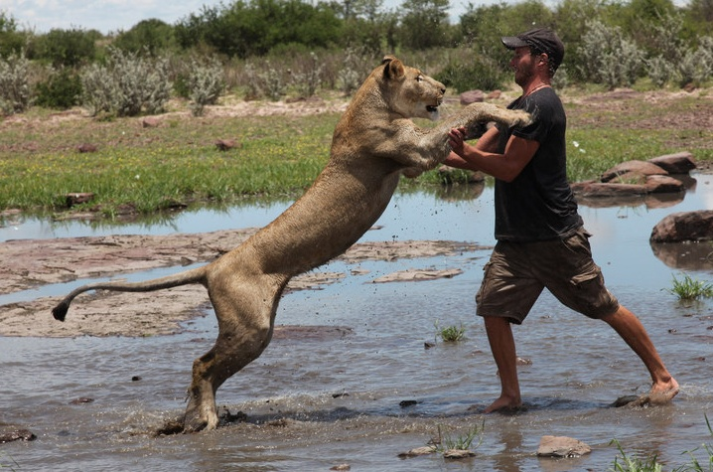

Introduction
Defensive responses are crucial for survival in dangerous environments!

Slide 3


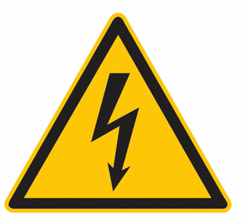
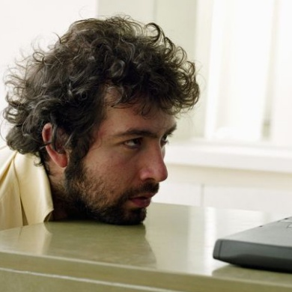
Introduction
Many animals typically respond with freezing behavior to threat
Immobility:
Reduced visibility
Planning:
Risk assessment
Action Preperation
Freezing
State of
Attentive Immobility
Cardiac deceleration
Orienting:
Enhanced sensory intake

Slide 4
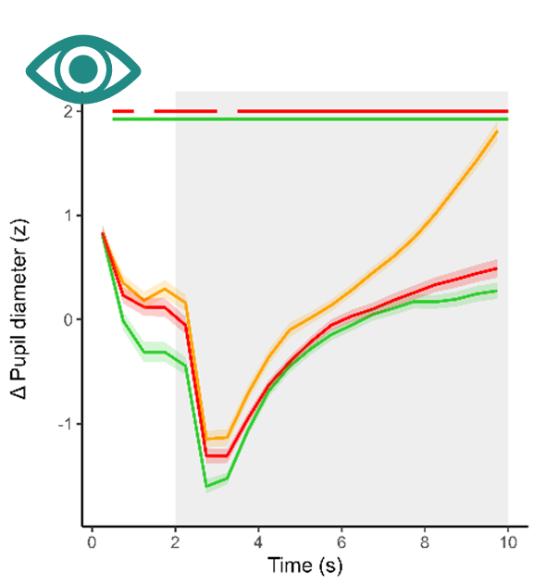
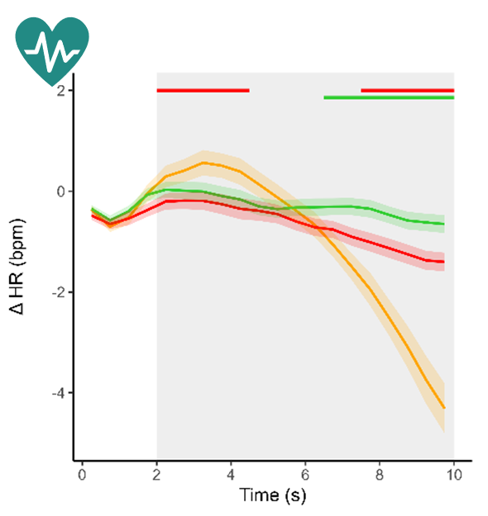
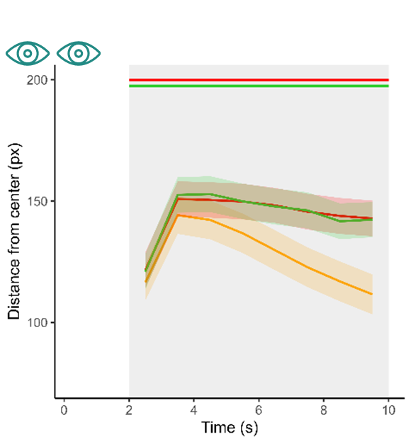
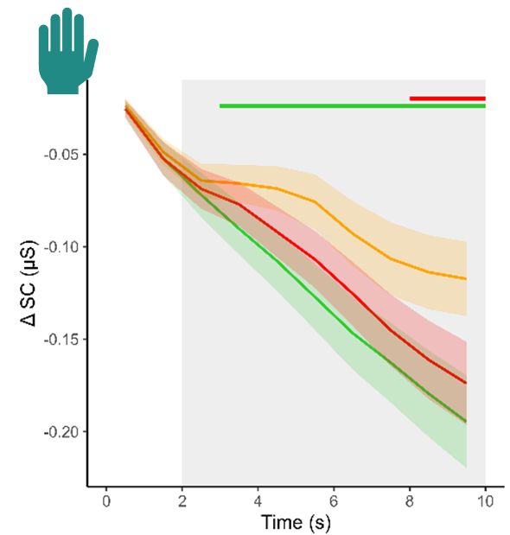

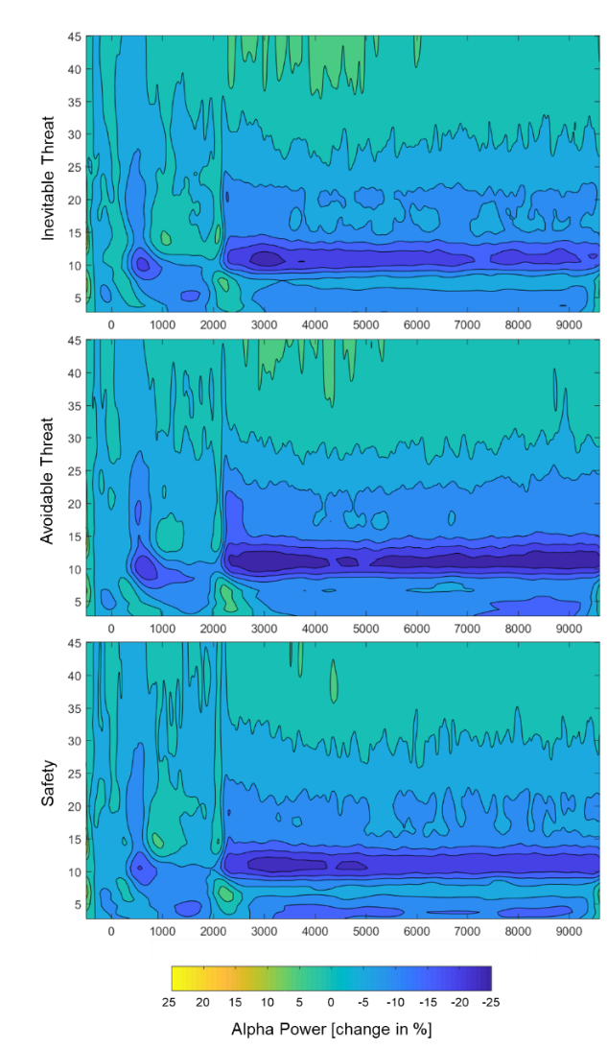
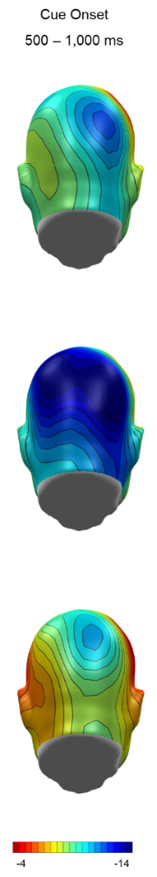
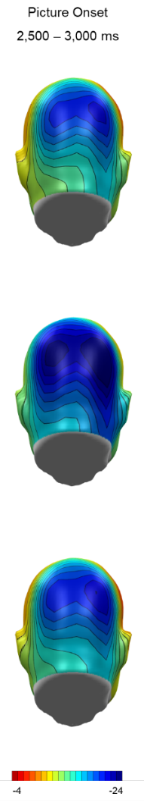
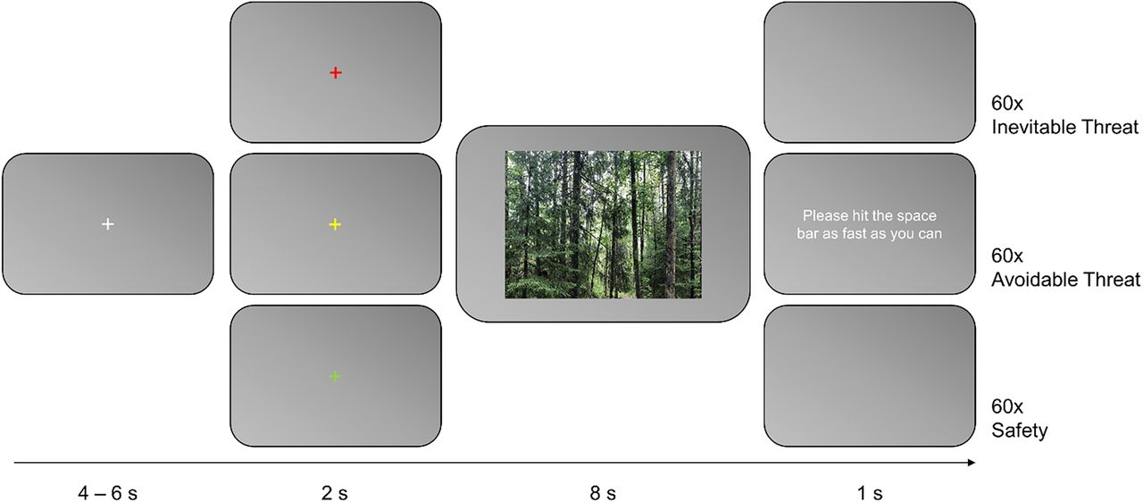
Attentive Immobility in Humans
Passive vs. active threat anticipation:
n = 101 healthy participants

Slide 5





Current Study
Research question:
  To what extent are psychophysiological fear responses influenced by motor preparation mechanisms compared to perceived threat?
Methods:
+
40x Inevitable High-Intensity
Subjects:
N = 48
Stimuli:
High: 6 ± 0
Low: 1.92 ± 1.08
0 = “not painful at all”
4 = “minimally painful”
10 = “very painful”
!
Hit the space bar!
40x Avoidable High-Intensity
+
+
40x Inevitable Low-Intensity
!
Hit the space bar!
40x Avoidable Low-Intensity
6.5 – 8.5 s
2 s
8 s
1 s
https://osf.io/2kp4s

Slide 6

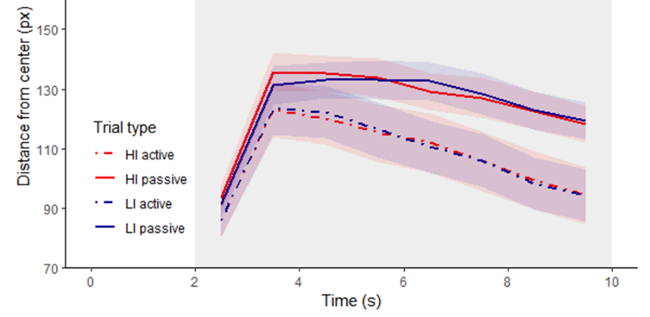
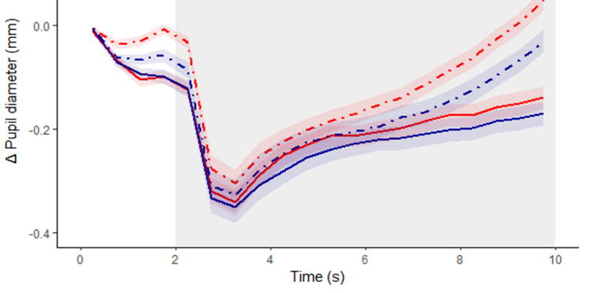
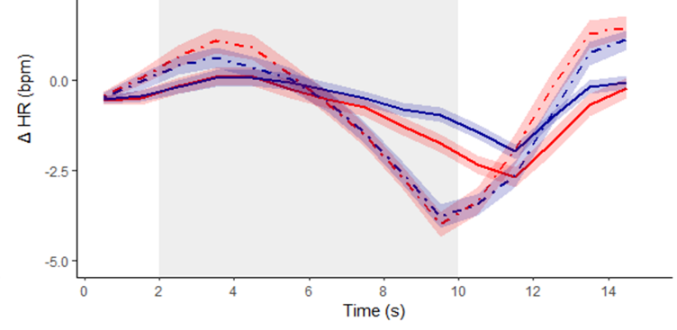
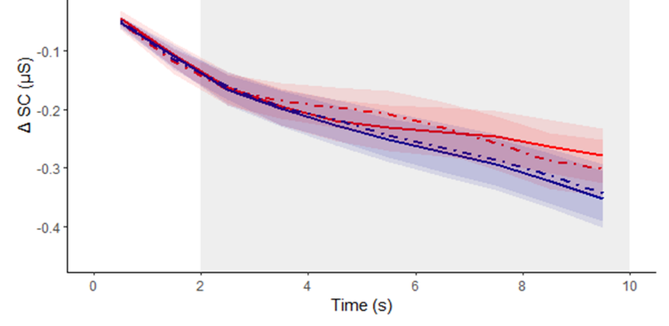
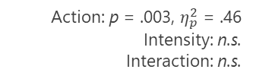
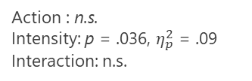
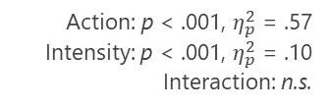
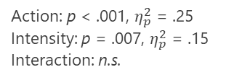
Results
Action: p = .003, $η_{p}^{2}$ = .46
Intensity: n.s.
Interaction: n.s.
Action: p < .001, $η_{p}^{2}$ = .25
Intensity: p = .007, $η_{p}^{2}$ = .15
Interaction: n.s.
Action: p < .001, $η_{p}^{2}$ = .57
Intensity: p < .001, $η_{p}^{2}$ = .10
Interaction: n.s.
Action : n.s.
Intensity: p = .036, $η_{p}^{2}$ = .09
Interaction: n.s.
https://osf.io/2kp4s

Slide 7
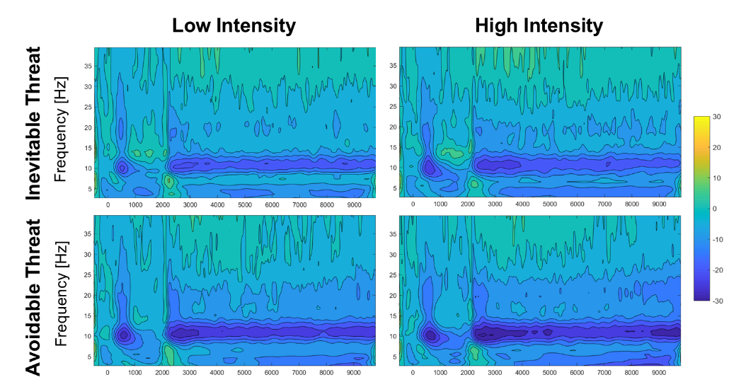

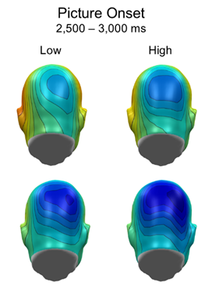
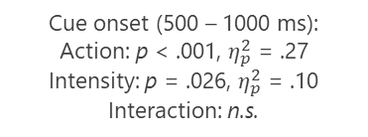
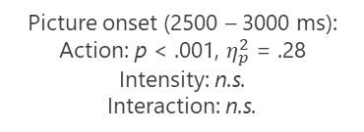
Results
Cue onset (500 – 1000 ms):
Action: p < .001, $η_{p}^{2}$ = .27
Intensity: p = .026, $η_{p}^{2}$ = .10
Interaction: n.s.
Picture onset (2500 – 3000 ms):
Action: p < .001, $η_{p}^{2}$ = .28
Intensity: n.s.
Interaction: n.s.
https://osf.io/2kp4s

Slide 8
Discussion
Interim Summary:
  Reduced eye movements
  Increased pupil dilation
  Increased heart rate deceleration
  Increased skin conductance level
  Increased alpha suppresssion
State of
Attentive Immobility
Perceived threat level
Action preparation
→ Conceptual differences between motor preperation and threat responses?
Notes:
What are the qualitative, the conceptual differences between motor preperation and threat responses. Why do thy look so similar on a physiological level?
Threat response -> we think about fight-or-flight, which is basically also a motor response. All the physiological adaptations prepare for action.
Is our threat response just a motor response? Also when we look at fMRI studies, usually the supplementary motor areas, and pre-motor areas are highly active.
Thus, in our passive fear conditioning study, is the physiology we are measuring just an „inhibited motor response“ because no action is possibly?

Slide 9
Discussion
Interim Summary II:
  Faster response times for high-intensity (286.74 ± 52.96 ms) vs. low-intensity (308.44 ± 55.36 ms) trials, t(47) = 5.53, p < .001, d = .80, suggest stronger motor preparation for high-intensity US.
Confoundation of action preperation and perceived levels of threat.
Perceived threat level
Motivational relevance
Defense system
Action preparation

Slide 10
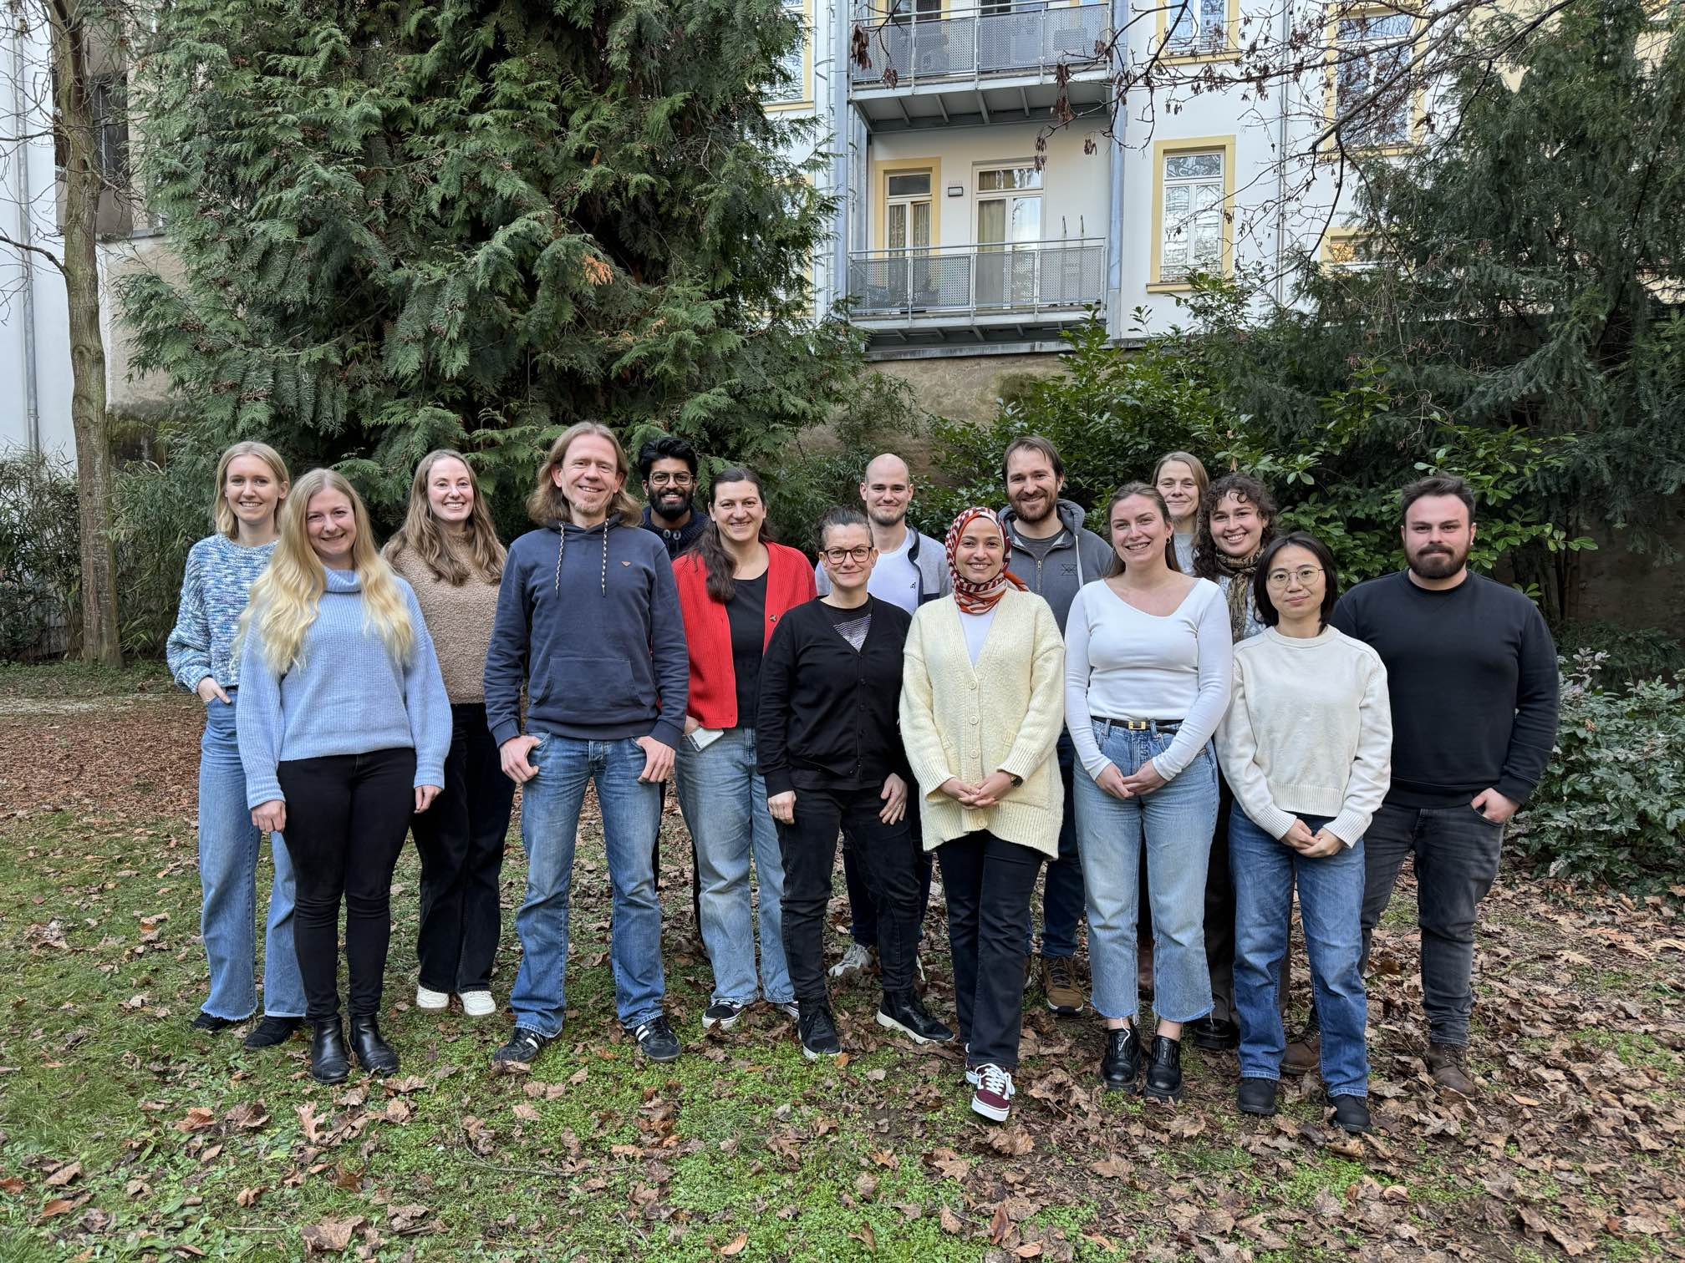
Thank you for your attention
Gamer Lab:
Yannik Stegmann - University of Würzburg
Mail: yannik.stegmann@uni-wuerzburg.de Bluesky: @yannikstegmann.bsky.social

