Slide 1
Electrocortical correlates of memory and attention during the anticipation of avoidable and inevitable threats
Yannik Stegmann
21.10.2025

Slide 2


Introduction
Defense responses are crucial for survival in dangerous environments!
Immobility:
Reduced visibility
Planning:
Risk assessment
Action Preparation
State of
Attentive Immobility
Freezing
Cardiac deceleration
Orienting:
Enhanced sensory intake

Slide 3


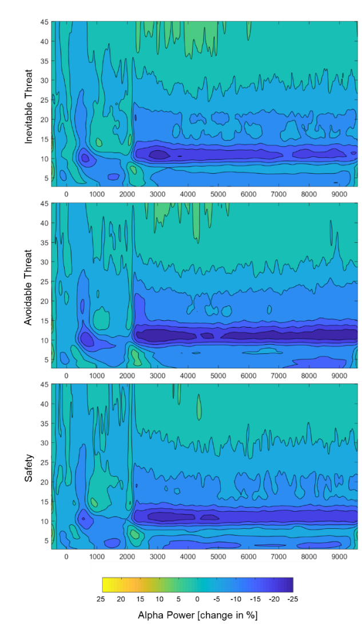
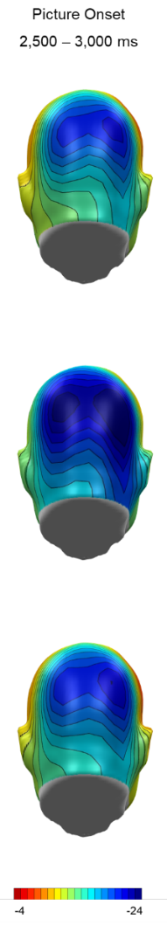
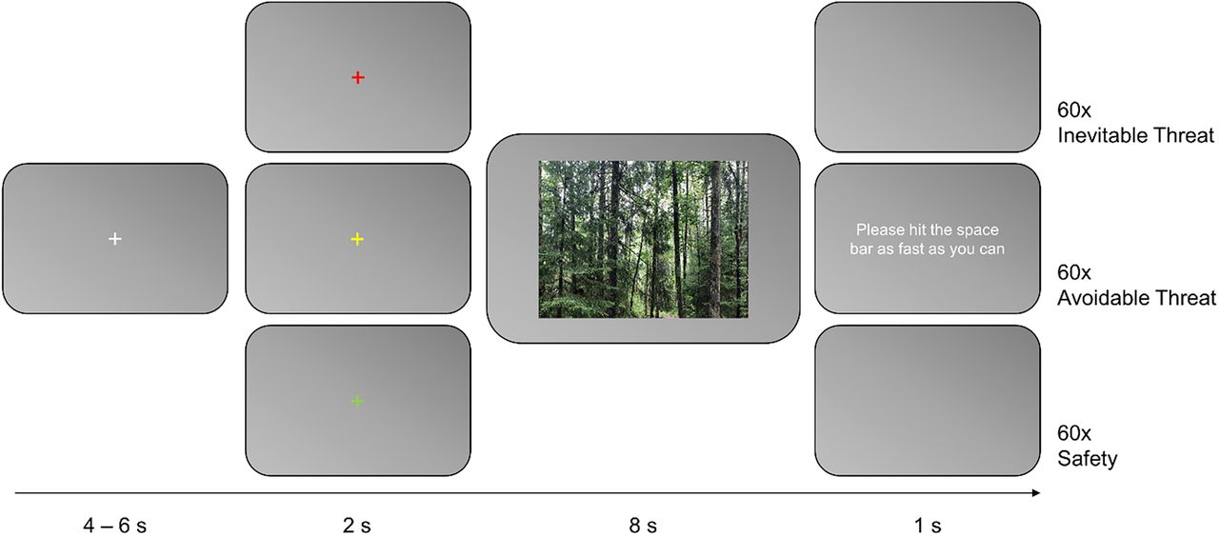




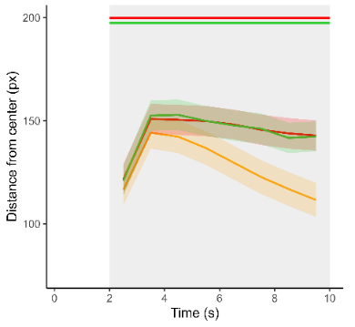
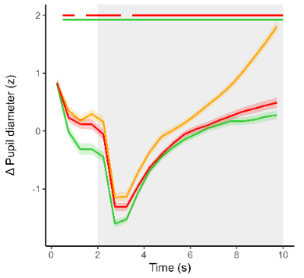
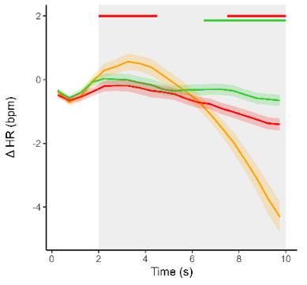
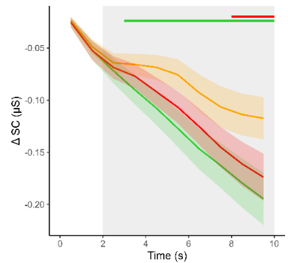
Attentive Immobility in Humans
Get the paper!
Passive vs. active threat anticipation:
n = 101 healthy participants

Slide 4
Research Question
Does the state of attentive immobility facilitate memory encoding?
Immobility:
Reduced visibility
Planning:
Risk assessment
Action Preparation
State of
Attentive Immobility
Freezing
?
Cardiac deceleration
Orienting:
Enhanced sensory intake
Memory Encoding
Hanslmayer et al., 2012; 2014
Leimeister et al., 2023

Slide 5






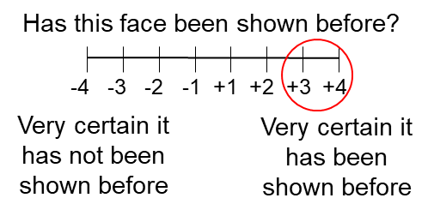




Methods
Threat Task:
Memory Task:
90 familiar faces
+ 60 novel faces
+
90 trials (3x30 faces)
+
+
90 trials (3x30 faces)
+
90 trials
(3x30 faces)
4 – 6 s
2 s
6 s
1 s
Neural activity
Heart Rate
Pupil
n = 60 (46 female, age = 23.4 ± 3.6)

Slide 6
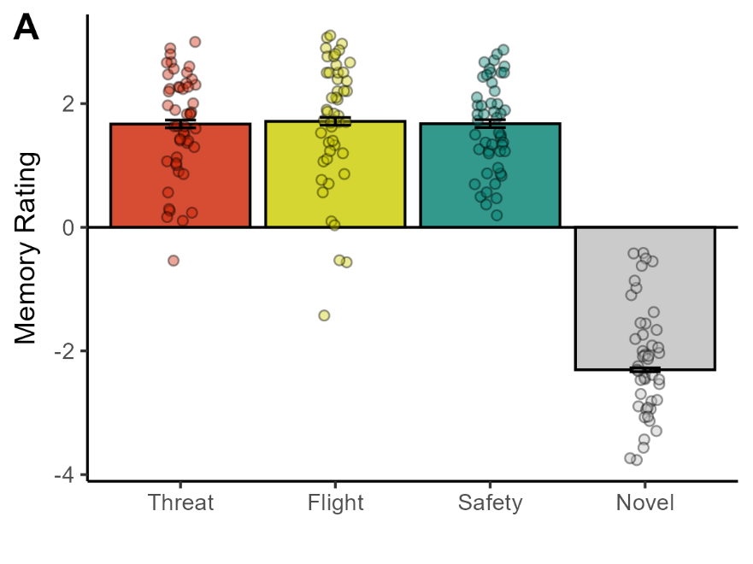
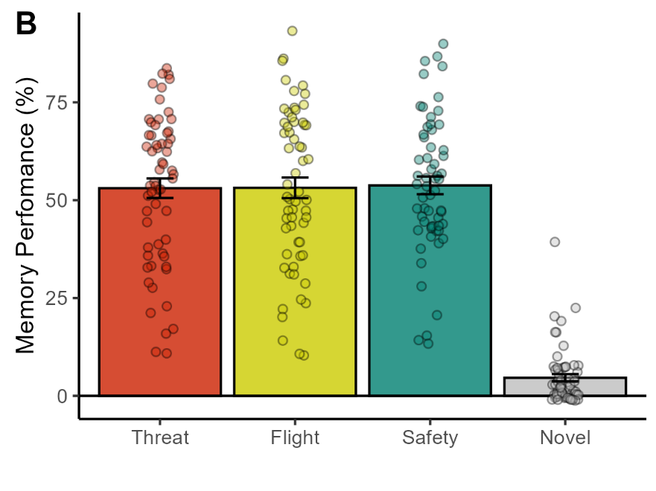

Results – Memory Task
90 familiar identities
60 novel identities
Condition: p = .840, $η_{p}^{2}$ < .01

Slide 7
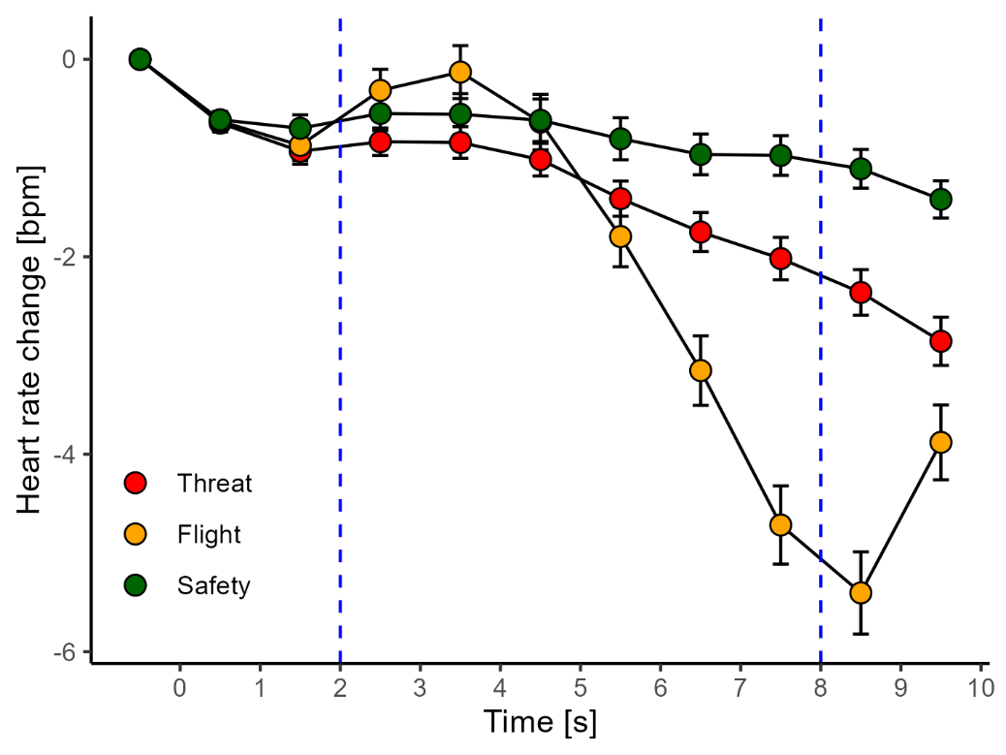
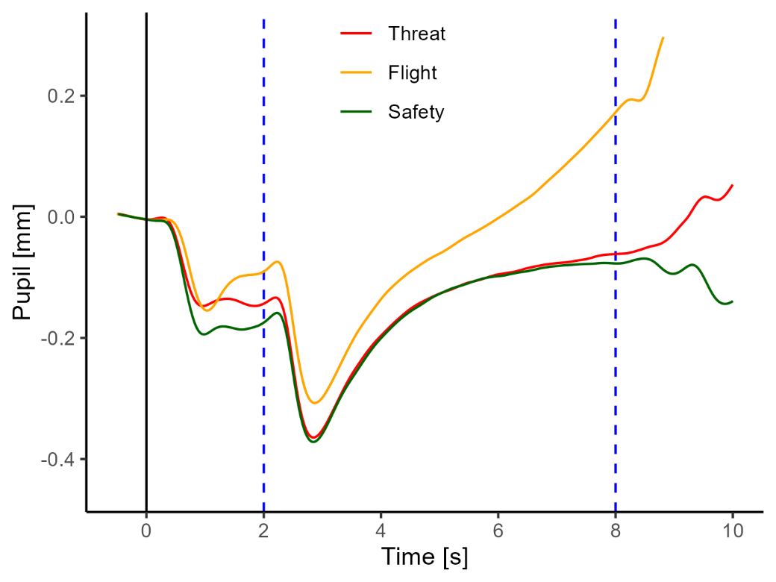
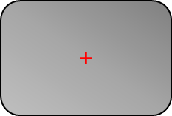
Results – Physiology
Heart rate:
Pupil dilation:
Post-hoc t-tests:
F-S: p = .001, d = .92
F-T: p = .001, d = .81
T-S: p < .001, d = .64
Cue onset t-tests:
F-S: p < .001, d = .96
F-T: p = .005, d = .37
T-S: p < .001, d = .60
Face onset t-tests:
F-S: p < .001, d = .94
F-T: p < .001, d = .86
T-S: p = .373, d = .12

Slide 8
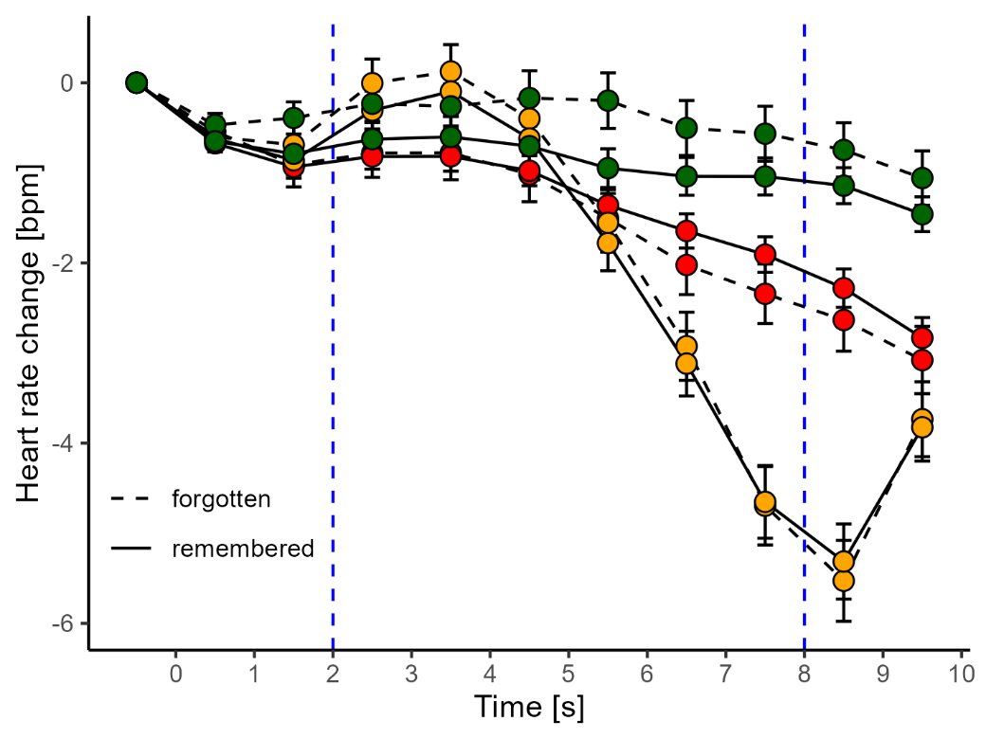
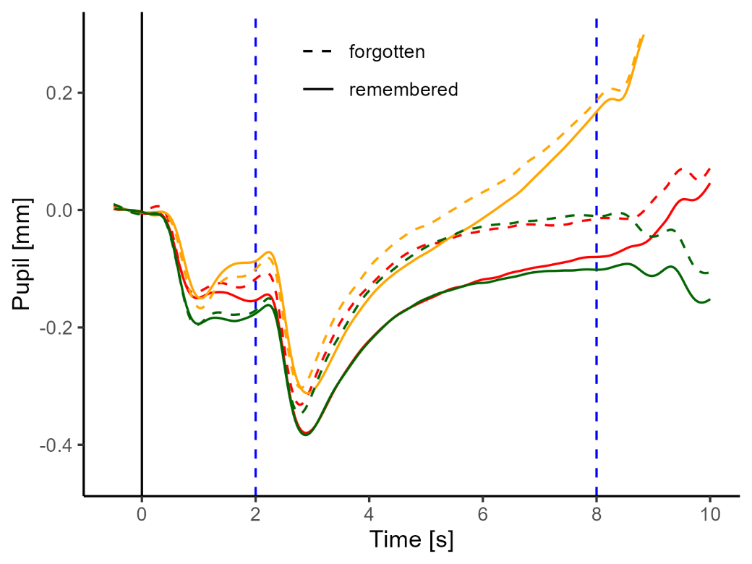
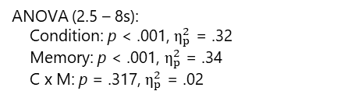
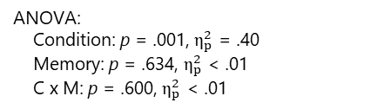
Results – Physiology SME
Heart rate:
Pupil dilation:
ANOVA:
Condition: p = .001, $η_{p}^{2}$ = .40
Memory: p = .634, $η_{p}^{2}$ < .01
C x M: p = .600, $η_{p}^{2}$ < .01
ANOVA (2.5 – 8s):
Condition: p < .001, $η_{p}^{2}$ = .32
Memory: p < .001, $η_{p}^{2}$ = .34
C x M: p = .317, $η_{p}^{2}$ = .02

Slide 9
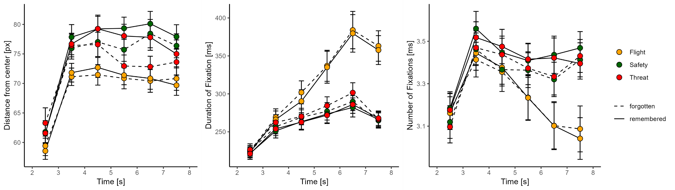

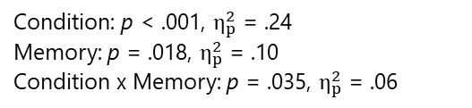

Results – Eye Tracking SME
Gaze:
Fixation Duration:
Number of Fixations:
Condition: p < .001, $η_{p}^{2}$ = .31
Memory: p = .031, $η_{p}^{2}$ = .08
Condition: p < .001, $η_{p}^{2}$ = .38
Memory: p = .029, $η_{p}^{2}$ = .08
Condition: p < .001, $η_{p}^{2}$ = .24
Memory: p = .018, $η_{p}^{2}$ = .10
Condition x Memory: p = .035, $η_{p}^{2}$ = .06

Slide 10
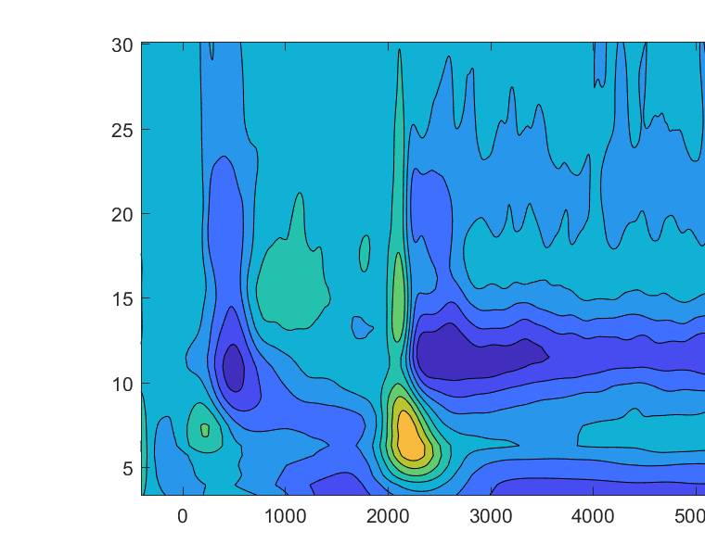
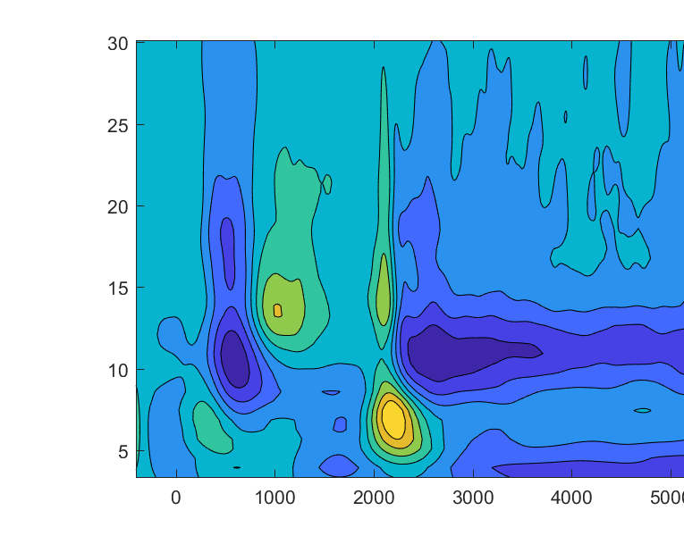
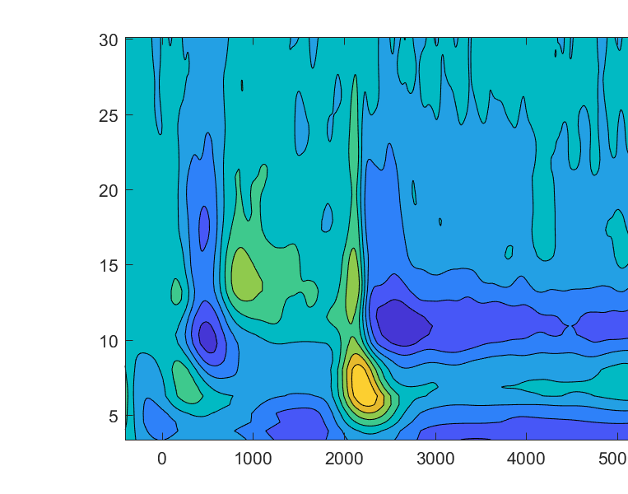

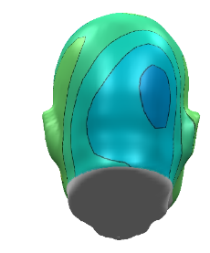
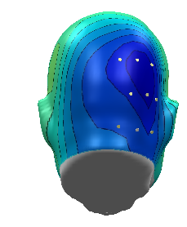
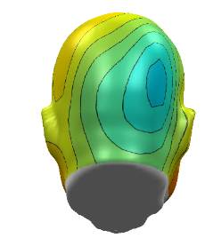
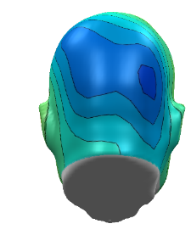
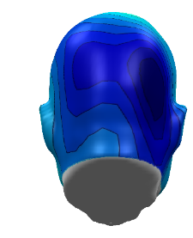
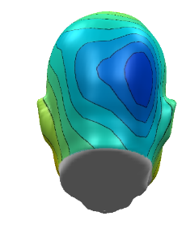
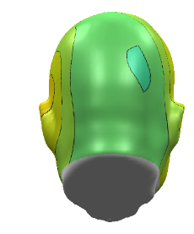
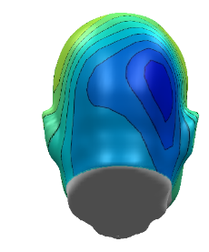
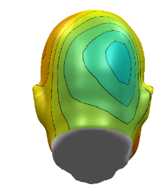

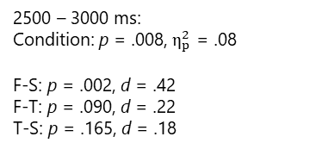
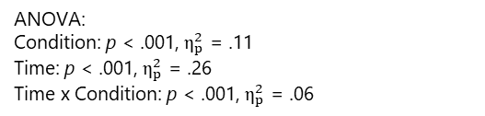
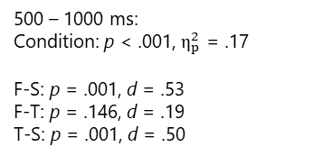
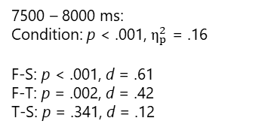
Results – Alpha Activity
Certain Threat
Flight
Safety
ANOVA:
Condition: p < .001, $η_{p}^{2}$ = .11
Time: p < .001, $η_{p}^{2}$ = .26
Time x Condition: p < .001, $η_{p}^{2}$ = .06
500 – 1000 ms:
Condition: p < .001, $η_{p}^{2}$ = .17
F-S: p = .001, d = .53
F-T: p = .146, d = .19
T-S: p = .001, d = .50
2500 – 3000 ms:
Condition: p = .008, $η_{p}^{2}$ = .08
F-S: p = .002, d = .42
F-T: p = .090, d = .22
T-S: p = .165, d = .18
7500 – 8000 ms:
Condition: p < .001, $η_{p}^{2}$ = .16
F-S: p < .001, d = .61
F-T: p = .002, d = .42
T-S: p = .341, d = .12

Slide 11
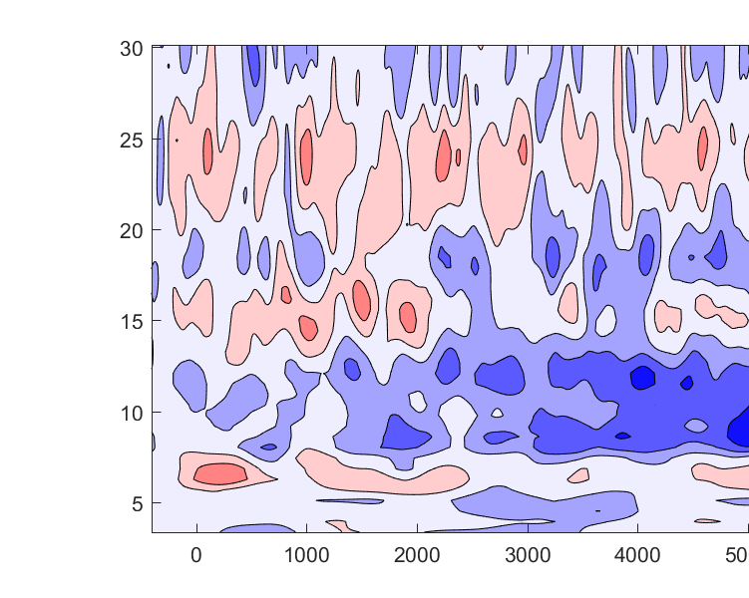
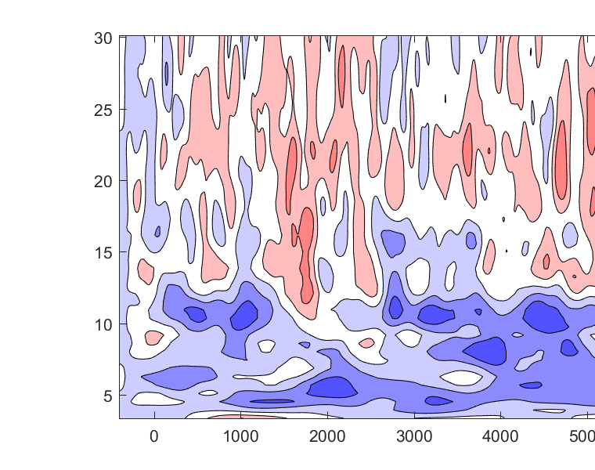
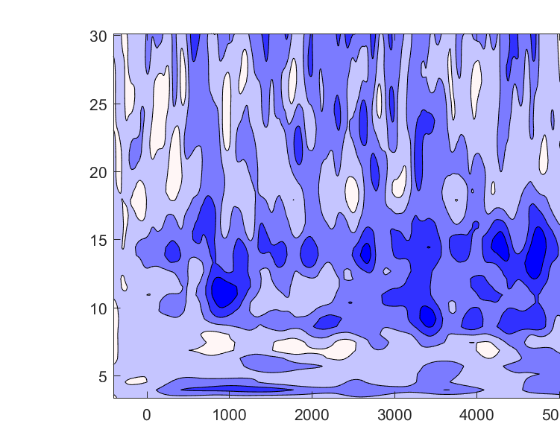

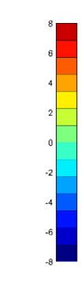
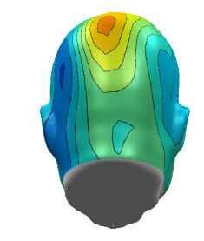
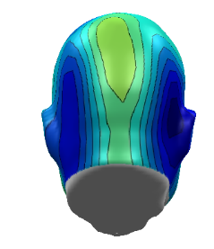
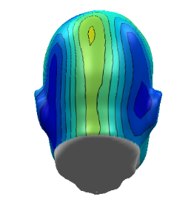
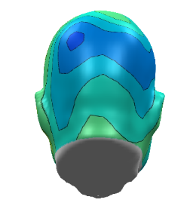
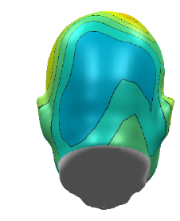
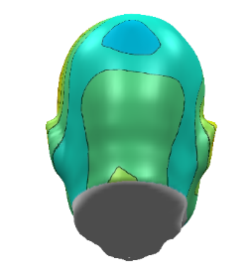
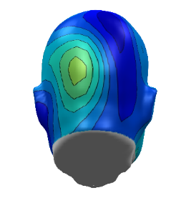
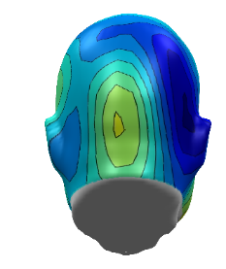
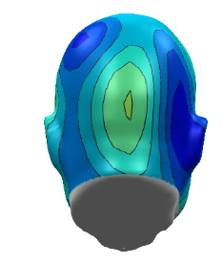

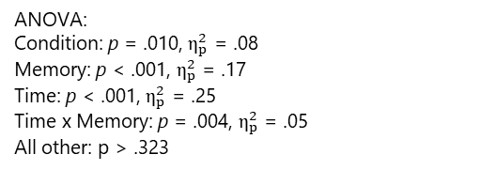


Results – Alpha Activity SME
Negative values:
Stronger alpha suppression for remembered vs. forgotten faces
Certain Threat
Flight
Safety
rem - for
ANOVA:
Condition: p = .010, $η_{p}^{2}$ = .08
Memory: p < .001, $η_{p}^{2}$ = .17
Time: p < .001, $η_{p}^{2}$ = .25
Time x Memory: p = .004, $η_{p}^{2}$ = .05
All other: p > .323
500 – 1000 ms:
Condition: p = .001, $η_{p}^{2}$ = .13
Memory: p = .008, $η_{p}^{2}$ = .11
Memory x Condition: p = .224, $η_{p}^{2}$ = .02
2000 – 5000 ms
p = .049, $η_{p}^{2}$ = .05
p > .001, $η_{p}^{2}$ = .18
p = .447, $η_{p}^{2}$ = .01
5000 – 8000 ms:
p < .001, $η_{p}^{2}$ = .12
p < .001, $η_{p}^{2}$ = .17
p = .149, $η_{p}^{2}$ = .03

Slide 12
Results – Action preperation
Response times
Mean = 323.0 ms
SD = 104.2 ms
 | All trials
Variable | β | SE | t | p
Alpha | .036 | .016 | 2.53 | .011
CB | .017 | .017 | 1.00 | .317
nFix | .032 | .027 | 1.21 | .228
durFix | -.055 | .027 | 2.31 | .021
Pupil | -.028 | .014 | 1.97 | .048
HR | .056 | .016 | 3.45 | <.001
Parameters of the generalized linear mixed models predicting response times in avoidable threat trials. Note. CB: center bias; HR: heart rate; nFix: Number of Fixations; durFix: Fixation durations. p-values for each predictor were obtained based on Satterthwaite’s approximation of degrees of freedom.

Slide 13


Summary
State of
Attentive Immobility
State of attentive immobility:
Heart rate, alpha, pupil dilation, gaze behavior
Correlates with response times
Memory processes:
No effects on explicit memory recall
Neurophysiological correlates of memory encoding:
More visual exploration
Smaller pupil dilation (less arousal)
Stronger alpha suppression
Action Preparation
Memory Encoding
Consolidation?
Opposing mechanisms?

Slide 14
Discussion
No “global” state of attentive immobility:
Heightened arousal and increased alpha suppression during the anticipation of threat avoidance only benefit the motor response, but not memory encoding.
Arousal-biased competition theory: (Mather et al., 2011)
A particular item's priority determines whether arousal will enhance or impair perception of that item.
Arousal improves perception of high priority information and weakens perception of low priority information.
The actual facial identity was not goal relevant in the current design

Slide 15


Remember these faces!
University of Würzburg
Department of Psychology I - Experimental Clinical Psychology
Prof. Dr. Matthias Gamer
Emily Zoe Burlon
Menghuan Chen
Dr. Sabrina Gado
Dr. Daniel Gromer
Dr. Lea Hildebrandt
Dr. Mario Reutter
Ebru Ecem Tavacioglu
Janna Teigeler
Francesco Tortora
Linda Wilkin-Krug
Yannik Stegmann - University of Würzburg
Mail: yannik.stegmann@uni-wuerzburg.de Bluesky: @yannikstegmann.bsky.social

