Slide 1
The Impact of Aversive Contexts on Visuocortical Processing of Generalized Threat
Yannik Stegmann - University Würzburg
yannik.stegmann@uni-wuerzburg.de

Slide 2









Introduction
Survival depends on the ability to rapidly detect danger and respond appropriatly.
1) Using contextual information
2) Discriminating safety from danger
Vigilance
Selective attention

Slide 3
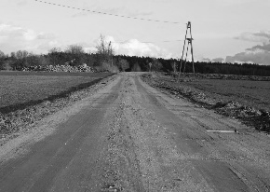
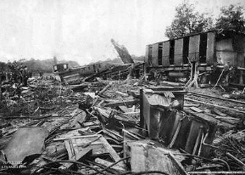

Introduction
1) Using contextual information
2) Discriminating safety from danger
CTX_{n}
CTX_{a}
CS-
CS+
The influence of aversive contexts on fear responses?

Slide 4
Introduction
1) Using contextual information
2) Discriminating safety from danger
CS-
CS+
CTX_{n}
CTX_{a}

Slide 5
Introduction
1) Using contextual information
2) Discriminating safety from danger
CTX_{n}
CTX_{a}
CS+
CS-

Slide 6
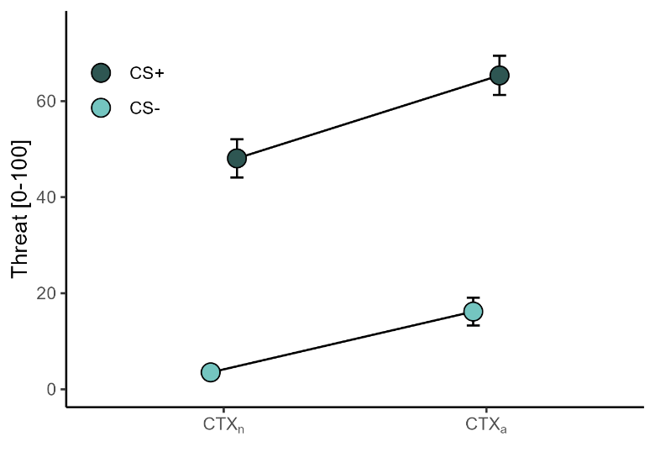
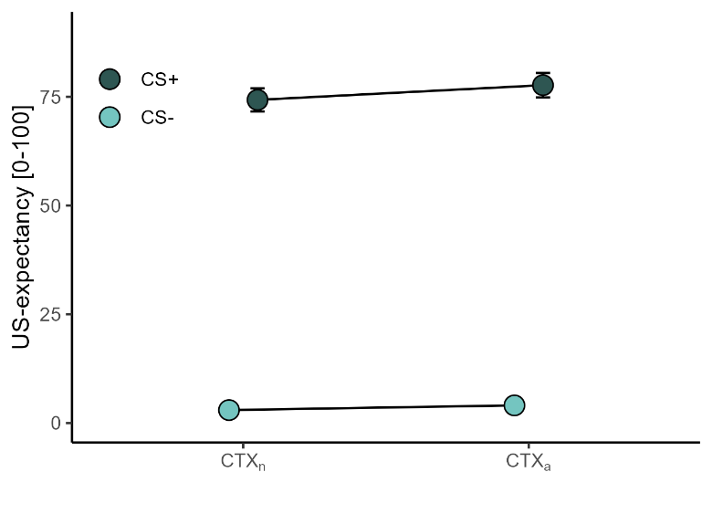
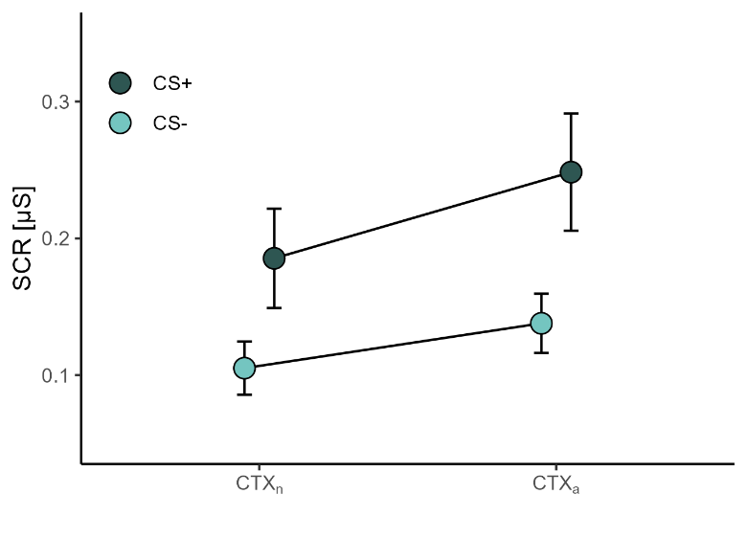
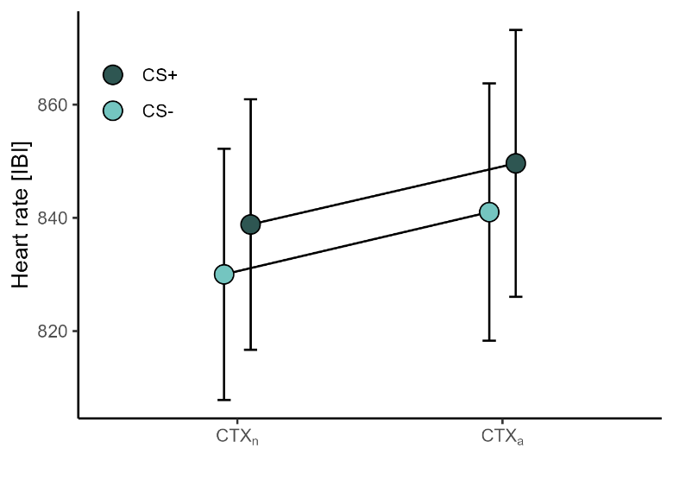
Introduction
CTX_{n}
CTX_{a}
CS+
CS-
Additive effects of aversive contexts on conditioned fear responses

Slide 7
Research Question
1) Using contextual information
2) Discriminating safety from danger
(McTeague et al., 2015)
-45°
15°
25°
35°
45°
55°
65°
75°
CS+
Vigilance
Selective attention
Competing attentional demands?

Slide 8
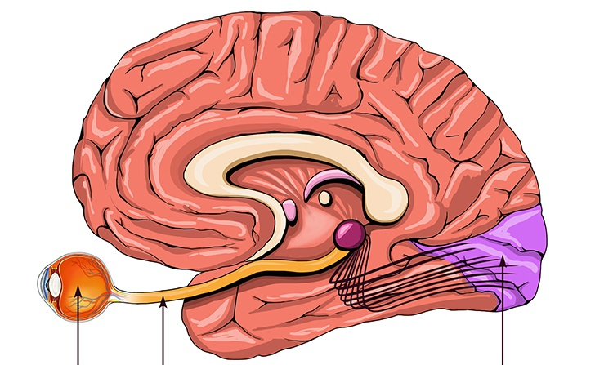
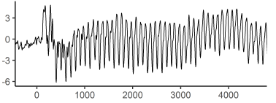

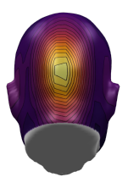

Electrocortical Indices of Attention
Steady-state visual evoked potentials (ssVEPs):
The ssVEP amplitude is a direct index of sustained visuocortical activity.
Luminence
Amplitude
Time
Time
EEG-sensor
Eye
Visual cortex
Amplitude
Visual
tract

Slide 9


Methods
Acquisition
CS+
-45°
15°
25°
35°
45°
55°
65°
75°
18x each
Context phase
6x
Aversive
6x
Neutral
-45°
15°
25°
35°
45°
55°
65°
75°
18x each per context
Sample
n = 48 (41 female)
Age: 23.1 ± 3.7
IUS: 40.5 ± 8.9
https://osf.io/a27yh

Slide 10


Design: Trial structure
Acquisition
18x CS+ (100% US)
ITI
18x each CS-
+
+
+
…
CS-Rating
4 s in 7.5 Hz
2-3 s
4 s in 7.5 Hz
ca. 15 min
Context phase
6x CTX_{a}
+
+
+
…
CS-Rating
6x CTX_{n}
+
+
+
…
CS-Rating
24x CS per block
18x CS+ in CTX_{a}
18x CS+ in CTX_{n}
18x each CS- in CTX_{a}
18x each CS- in CTX_{n}
160 s
https://osf.io/a27yh

Slide 11
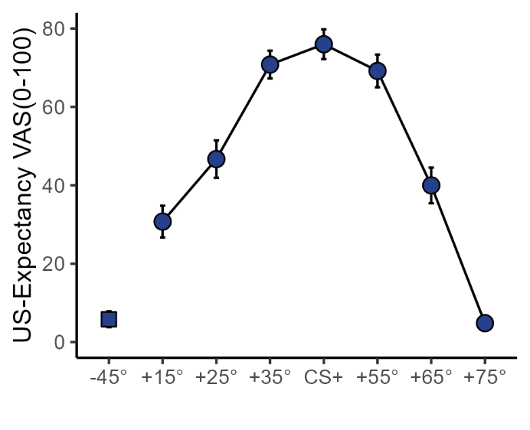
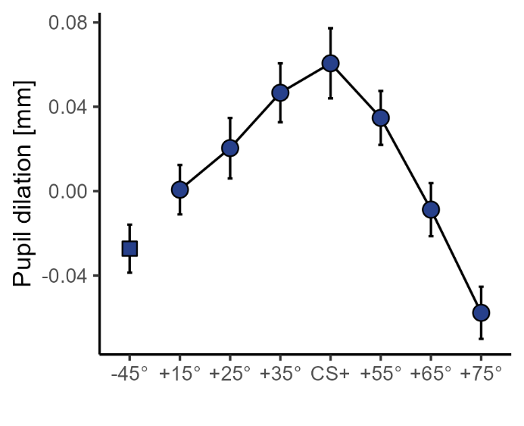


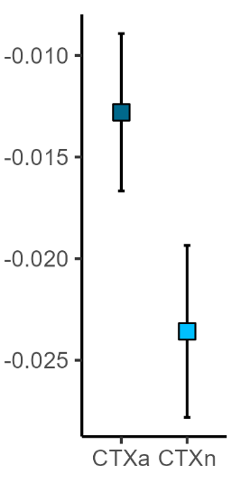
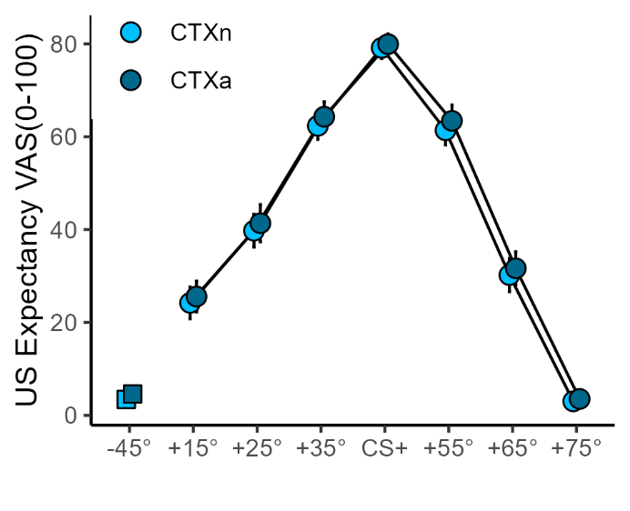
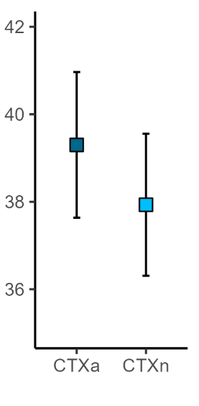
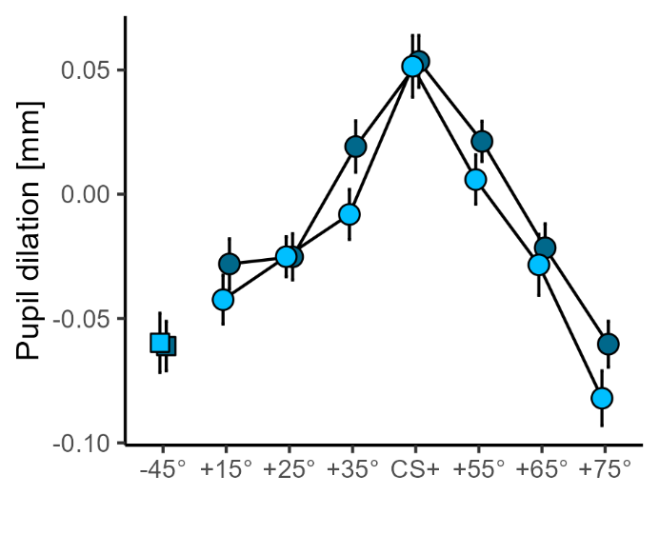





Results
Acquisition:
Cue: p = .001, $η_{p}^{2}$ = .56
Cue: p = .001, $η_{p}^{2}$ = .23
Context phase:
Cue: p = .001, $η_{p}^{2}$ = .75
Context: p = .039, $η_{p}^{2}$ = .08
Cue x Context: p = .991, $η_{p}^{2}$ = .01
Cue: p = .001, $η_{p}^{2}$ = .75
Context: p = .005, $η_{p}^{2}$ = .15
Cue x Context: p = .515, $η_{p}^{2}$ = .02
https://osf.io/a27yh

Slide 12
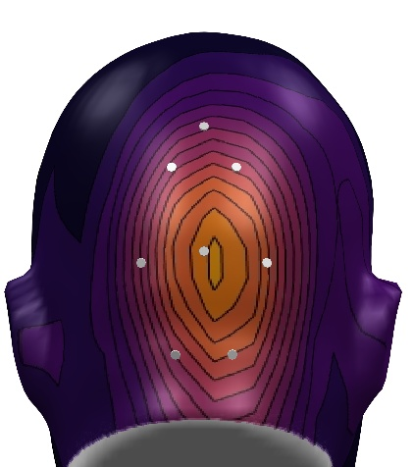

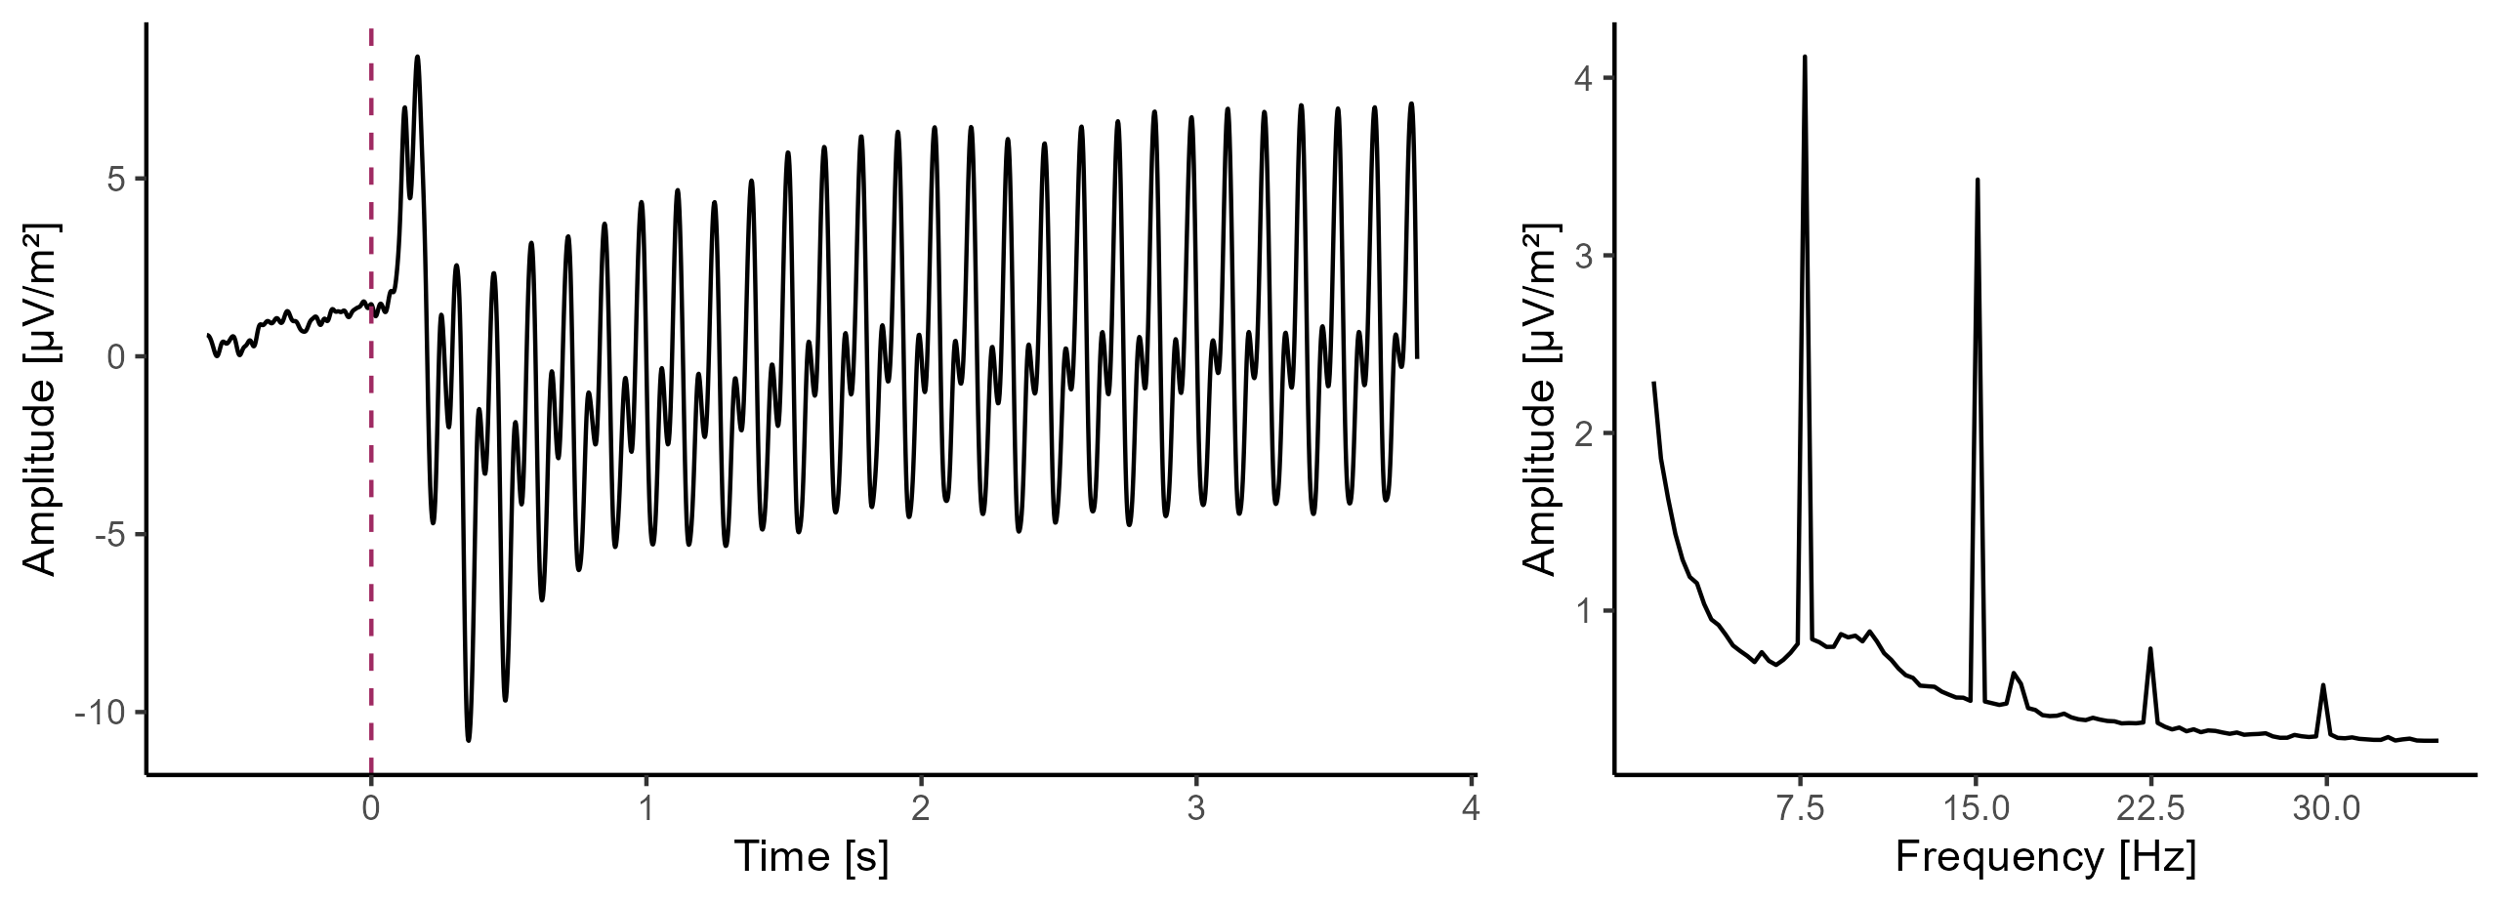
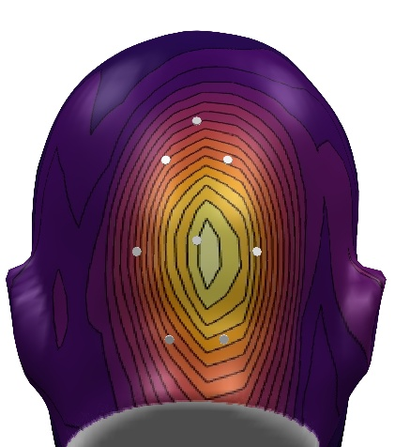
Results
EEG:
129-electrode geodesic net (EGI)
Offline filters: 1 – 40 Hz
-600 ms – 4,000 ms segments
SCADS artefact correction (Junghöfer et al., 2000)
CSD-transformation (Junghöfer et al., 1997)
7.5 Hz
(Fundamental)
SNR
15 Hz
(2nd Harmonic)
https://osf.io/a27yh

Slide 13
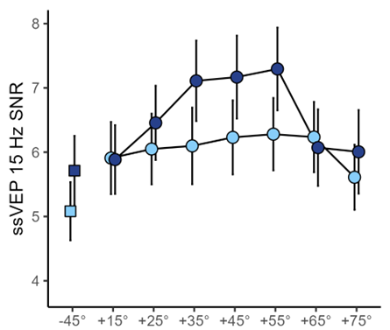
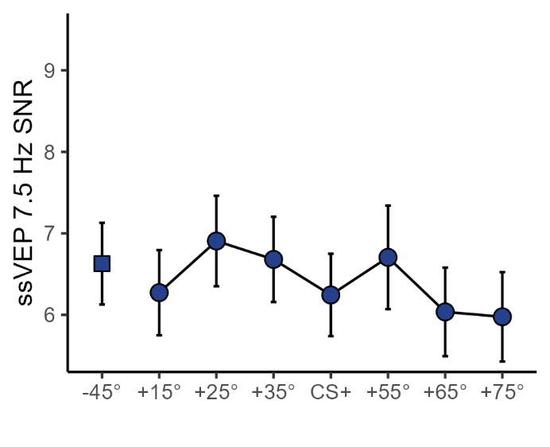
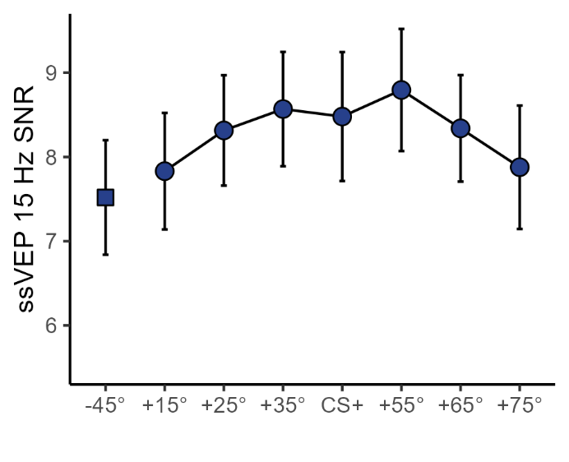

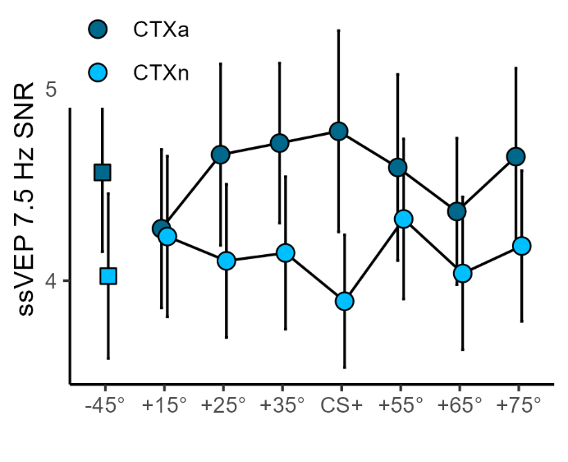
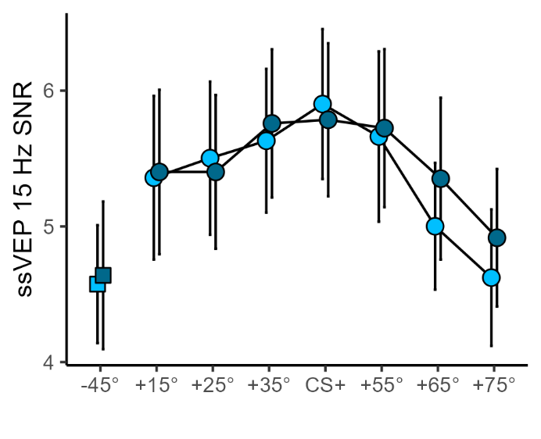





Results
Acquisition:
Cue: p = .057, $η_{p}^{2}$ = .04
Cue: p = .045, $η_{p}^{2}$ = .05
Context phase:
Cue: p = .830, $η_{p}^{2}$ < .01
Context: p = .002, $η_{p}^{2}$ = .19
Cue x Context: p = .309, $η_{p}^{2}$ = .02
Cue: p < .001, $η_{p}^{2}$ = .15
Context: p = .530, $η_{p}^{2}$ < .01
Cue x Context: p = .887, $η_{p}^{2}$ < .01
https://osf.io/a27yh

Slide 14

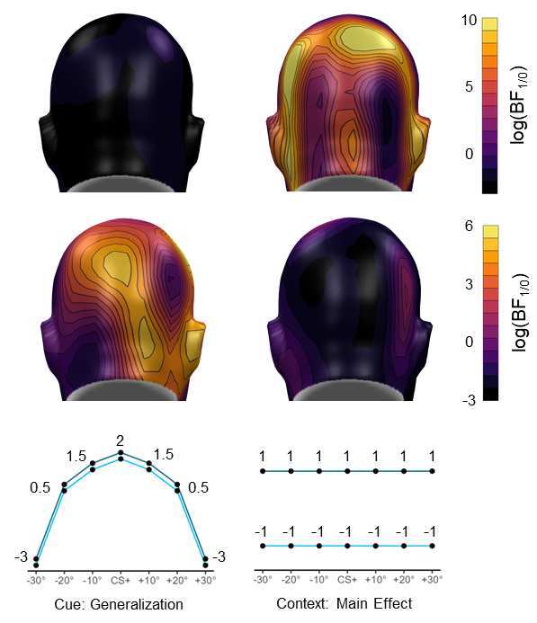
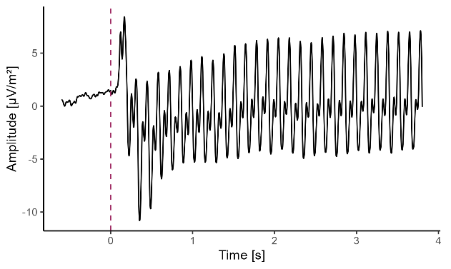
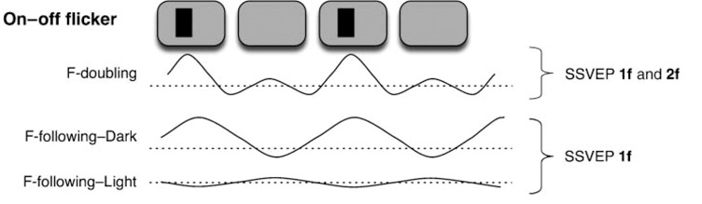
Results
Bayesian linear model comparisons per sensor:
(Kim et al., 2011)
Frequency-following neurons: simple cells
Frequency-doubling neurons: complex cells
Different sensitivity to contextual and central cue features
https://osf.io/a27yh

Slide 15
Discussion
Attentional processes during acute and potential threat:
Aversive contexts: hypervigilance – monitoring the environment, overall enhanced sensitivity of neural populations in visual areas.
Acute threat: selective attention – focusing on cues (“spotlight" methapor), re-tuning of neural populations to threat-relevant features.
Competing attentional demands:
The more the better
Threat detection is followed by selective attention, but focusing too much can lead to neglecting other dangers in the environment
Harmonic-based segregation of attentional mechanisms in visual areas:
Frequency-following (simple cells) and frequency-doubling (complex cells) neurons
Differently sensitive to contextual and central cue features
Maintaining both functions of selective attention and hypervigilance simultaneously

Slide 16
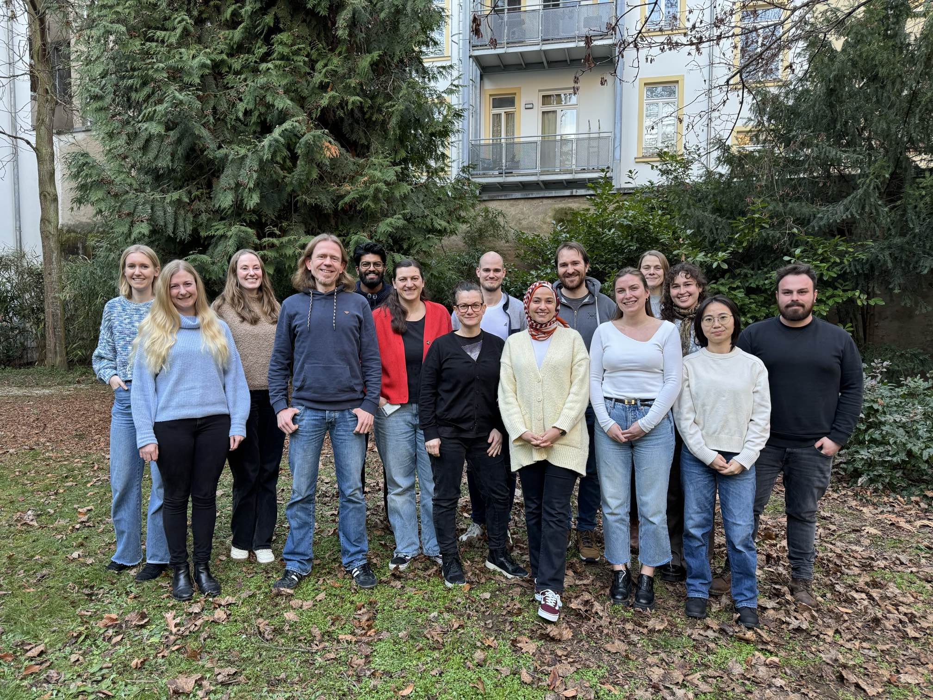
Thank you for your attention
Yannik Stegmann - University of Würzburg
Mail: yannik.stegmann@uni-wuerzburg.de Bluesky: @yannikstegmann.bsky.social

