Slide 1
EEG, Emotion, and Videos: Developments in Dynamic Emotional Processing Research Electrocortical Correlates of Sustained Attention During Contextual Anxiety and Extinction Learning
Yannik Stegmann
University of Würzburg
yannik.stegmann@uni-wuerzburg.de
21.10.2025
2024 Annual Meeting of the Society for Psychophysiological Research
2024 Annual Meeting of the Society for Psychophysiological Research

Slide 2
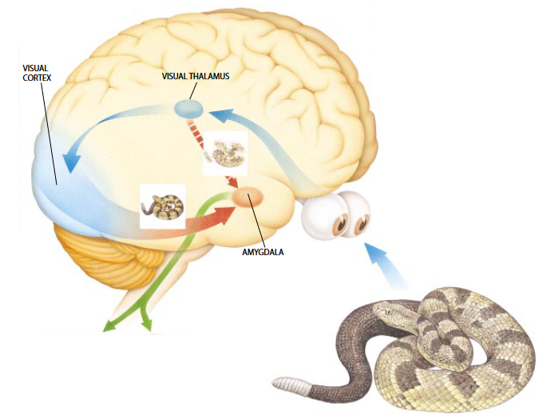



Introduction
Acute threat
Specific, imminent danger
Intense, phasic response
Fear
Selective attention
Potential threat
Unspecific, diffuse danger
Moderate, sustained response
Anxiety
Hypervigilance

Slide 3
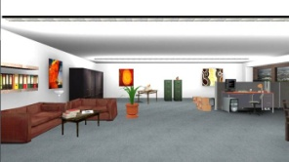
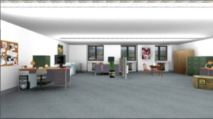
Context Conditioning
Modeling potential threat in the lab: (Davis et al., 2010 ; Kastner-Dorn et al., 2015)
Presentation of aversive stimuli (US) at random time points
In the absence of US-predicting cues
Threat context (CTX+)
Safety context (CTX-)

Slide 4
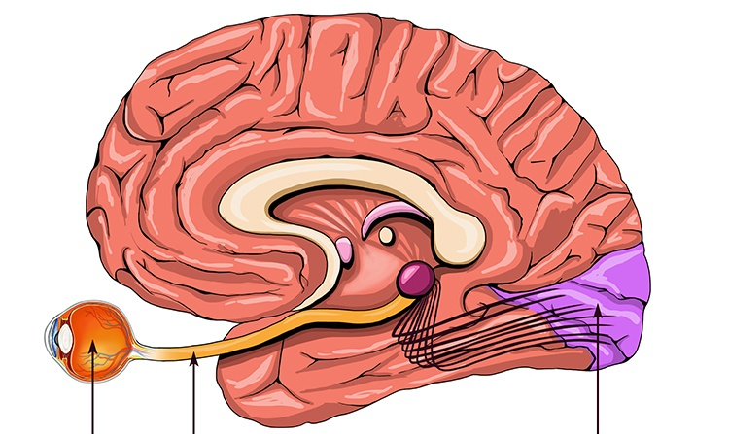
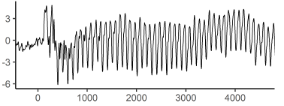
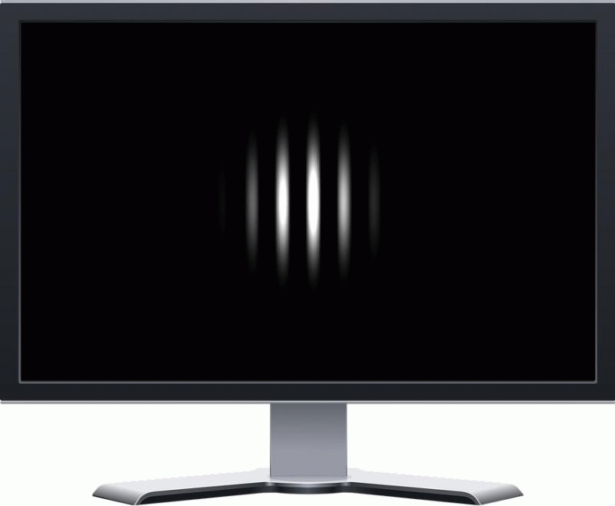
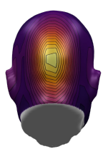

Electrocortical Indices of Attention
Steady-state visual evoked potentials (ssVEPs):
The ssVEP amplitude is a direct index of sustained visuocortical activity.
Luminence
Amplitude
Time
Time
EEG-sensor
Eye
Visual cortex
Amplitude
Visual
tract

Slide 5
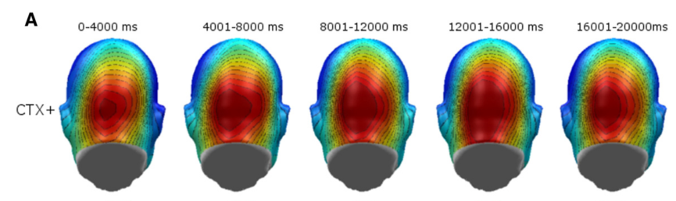
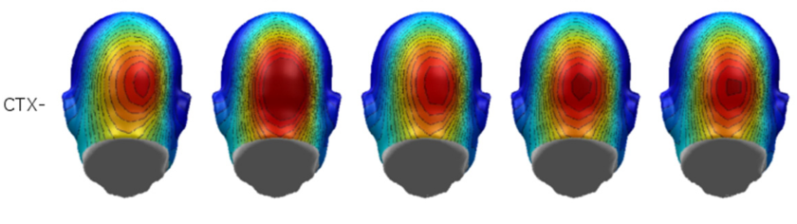
ssVEPs in Context Conditioning
Stronger sustained visuocortical activation during threatening contexts. (Kastner-Dorn et al., 2015)
Threat context (CTX+)
Safety context (CTX-)
15 Hz
“On-Off” Flicker

Slide 6
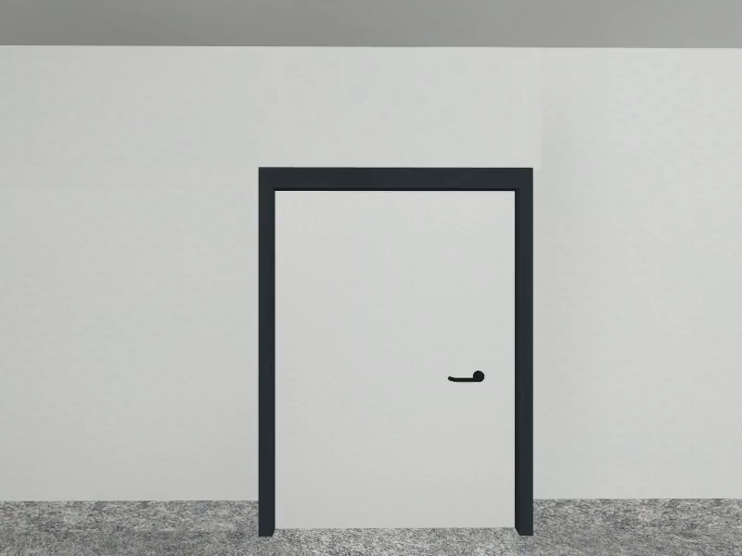
Research Goal
Context conditioning with flickering videos instead of static pictures?

Slide 7
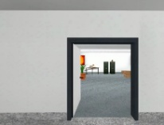
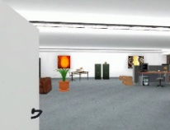
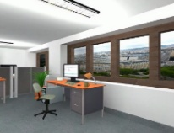
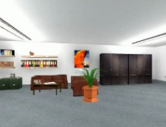
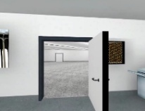
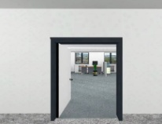
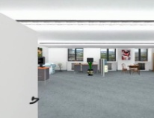
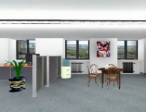

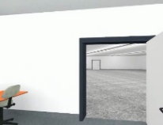
Method
Design:
Pre-Acquisition:
2x CTX+ (+1 with Ratings)
2x CTX- (+1 with Ratings)
Acquisition:
8x CTX+ (+2 with Ratings)
8x CTX- (+2 with Ratings)
Extinction:
8x CTX+ (+2 with Ratings)
8x CTX- (+2 with Ratings)
CTX-
20 Hz
CTX+
20 Hz
+
0 s - 7 s
Δt = 6 s
35 s
8 s – 10 s
0 s - 7 s
Δt = 6 s
35 s
Initial response
Sustained response
ITI
Initial response
Sustained response
0, 1, 2, or 3 US
2x each

Slide 8
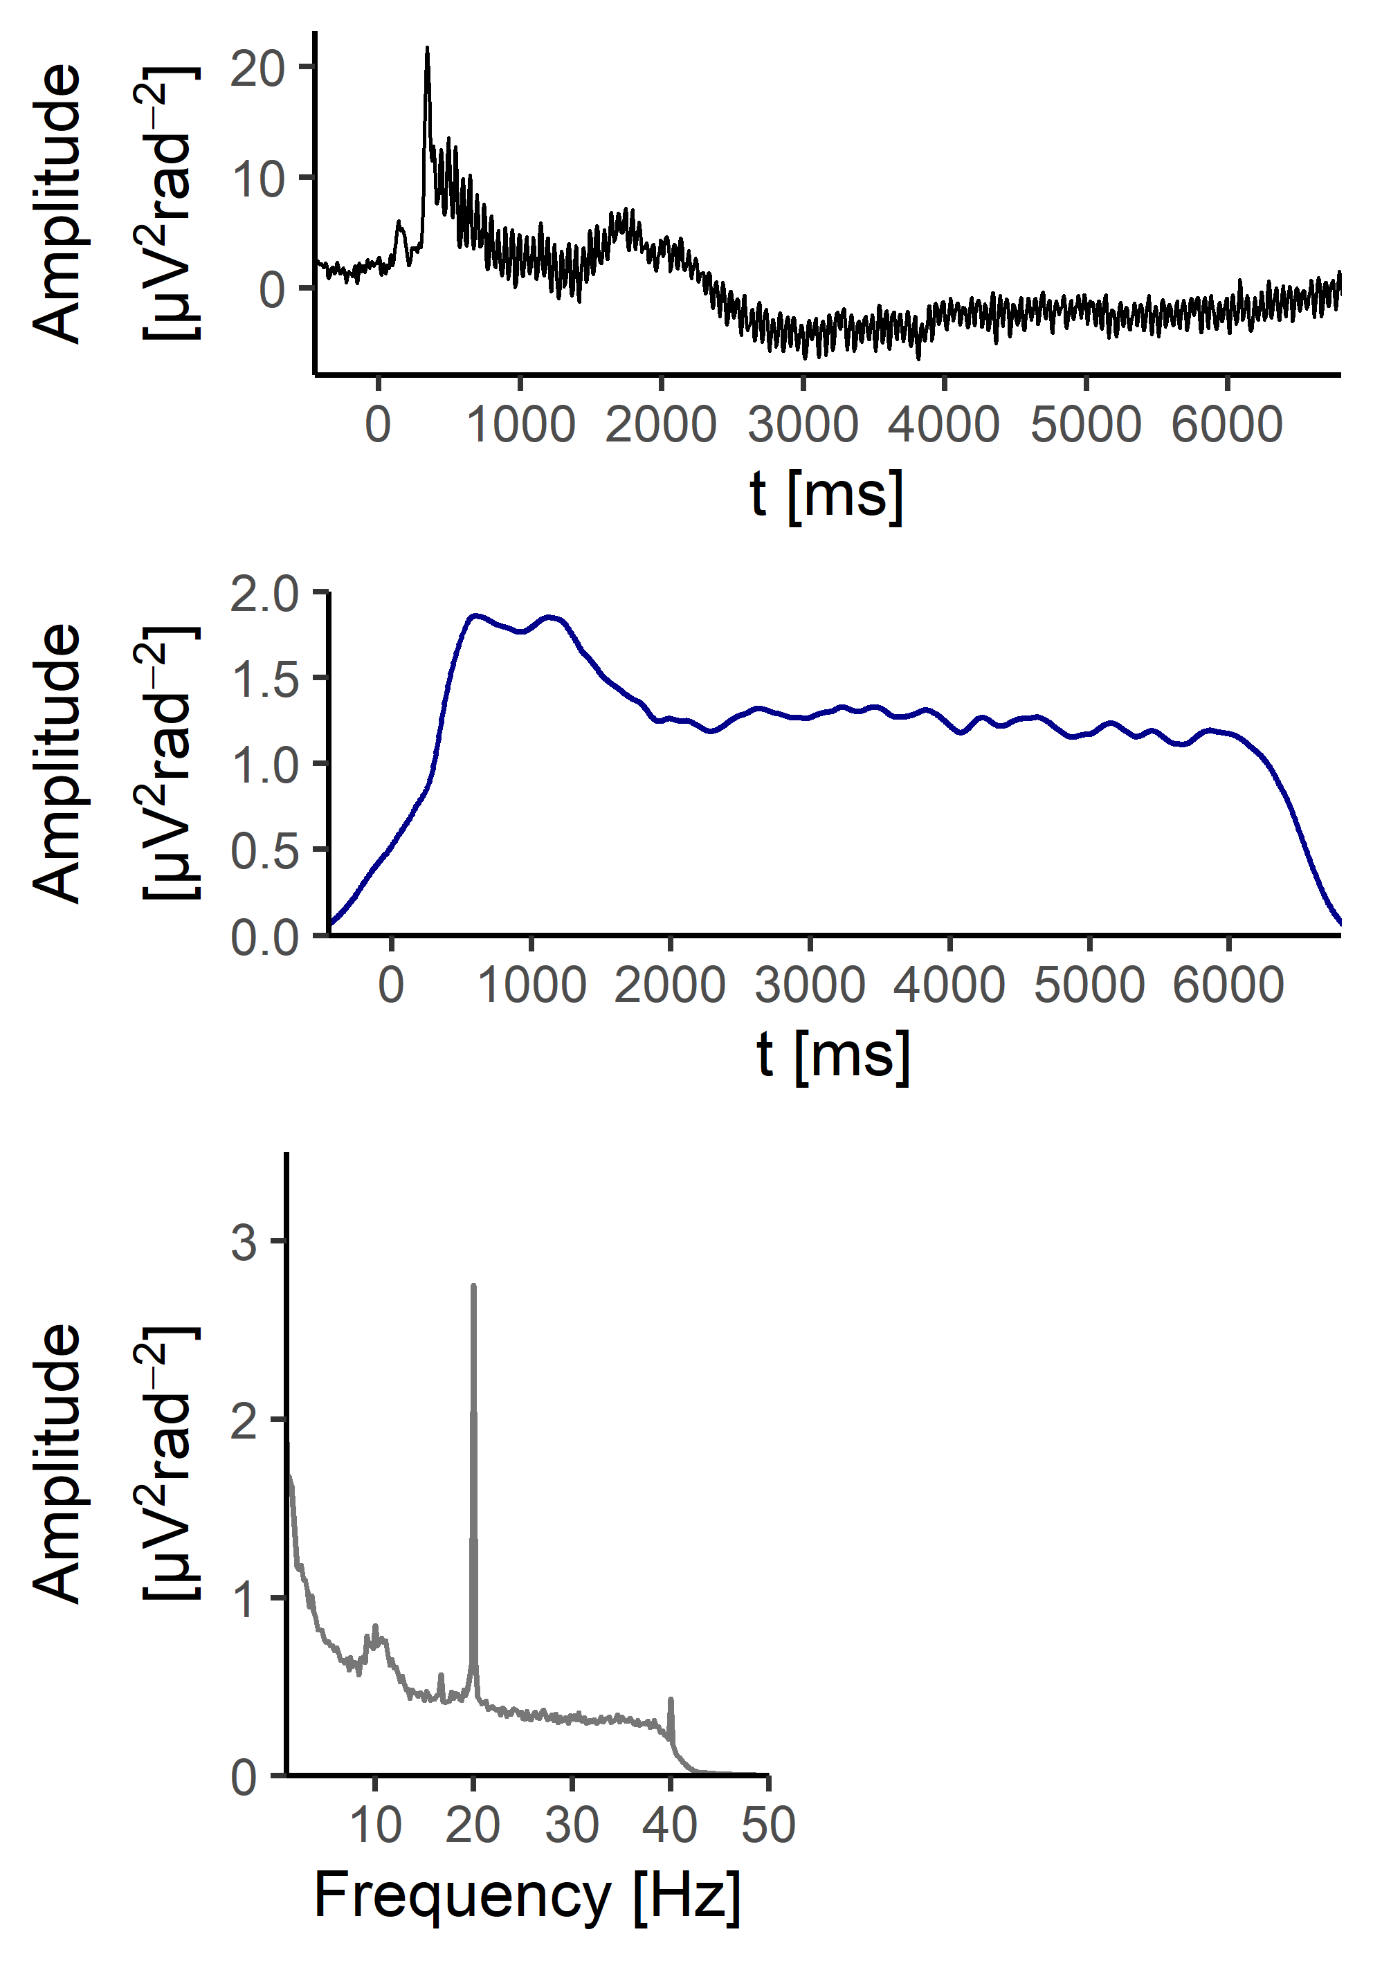
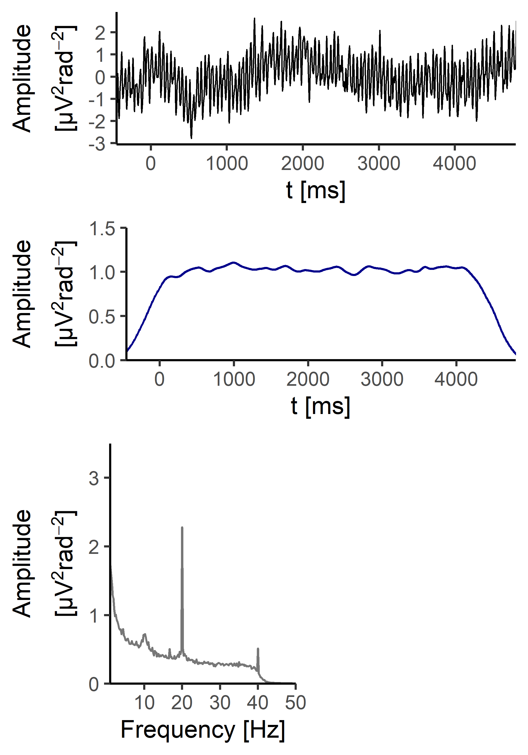
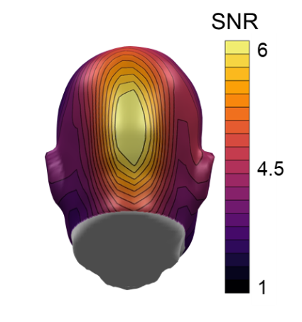
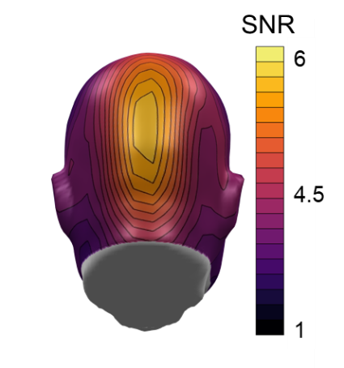
Method
Participants:
n = 38 healthy participants
24 female, 14 male
Age: 23.6 ± 3.7 years
EEG Pre-processing:
129-sensor HydroCel EGI
250 Hz sampling rate
SCADS (Junghöfer, 2000)
71% artefact-free trials
CSD-transform
Fast-Fourier-transform
EEG grand averages:
Initial response:
Sustained response:

Slide 9
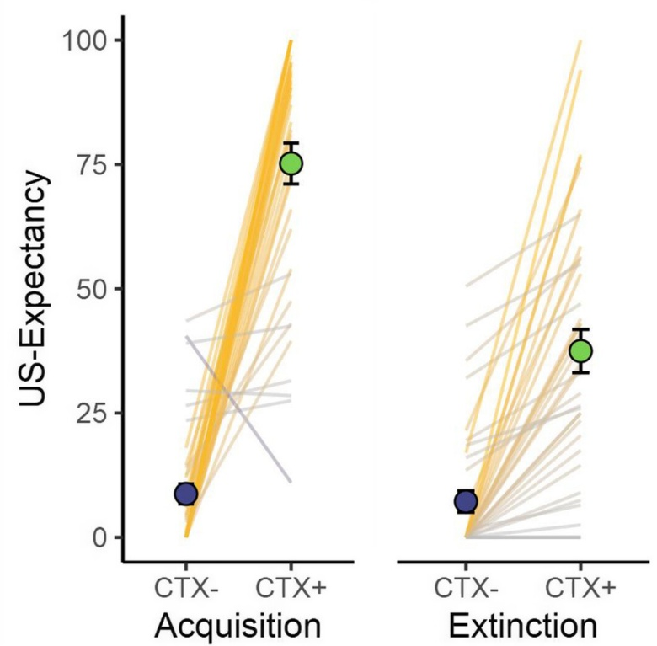
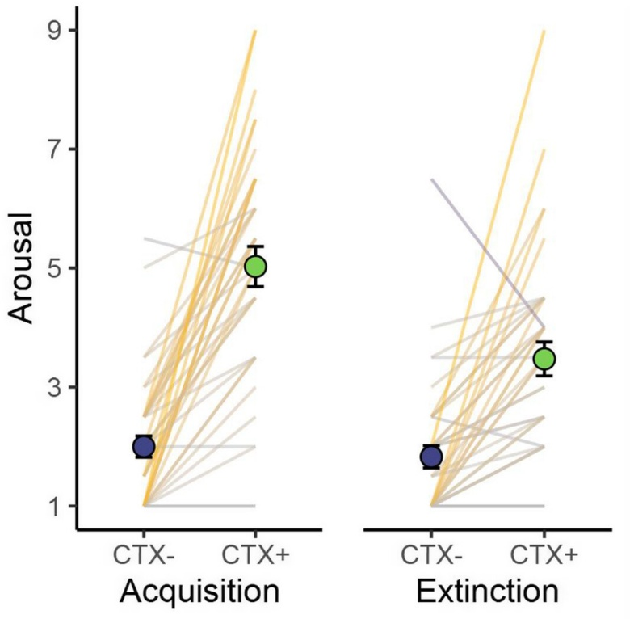
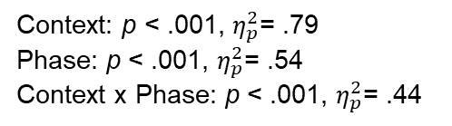
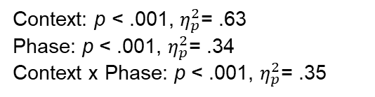
Results
Ratings:
Context: p < .001, $η_{p}^{2}$= .79
Phase: p < .001, $η_{p}^{2}$= .54
Context x Phase: p < .001, $η_{p}^{2}$= .44
Context: p < .001, $η_{p}^{2}$= .63
Phase: p < .001, $η_{p}^{2}$= .34
Context x Phase: p < .001, $η_{p}^{2}$= .35

Slide 10
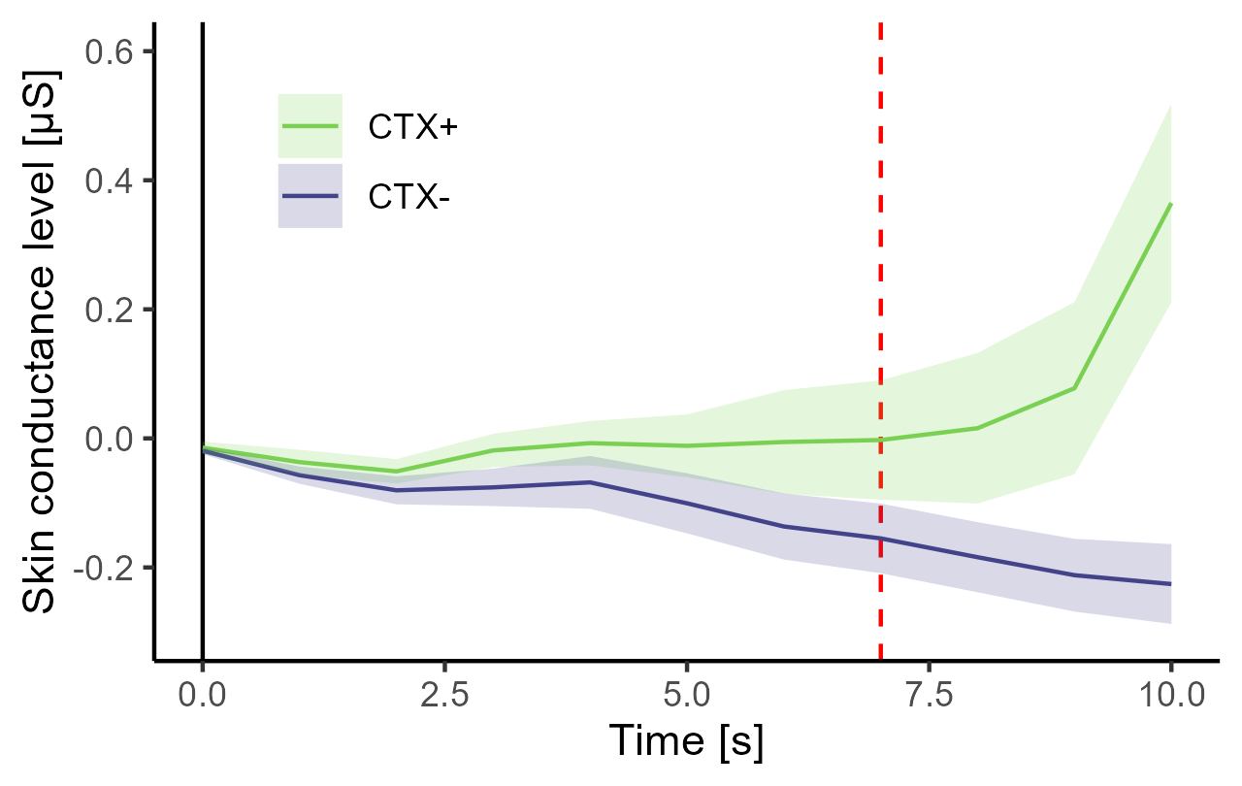
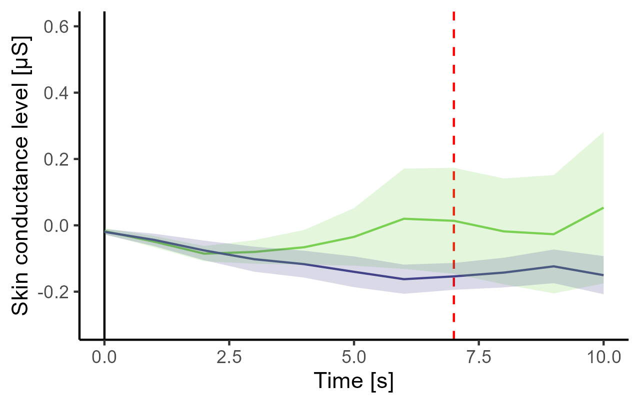
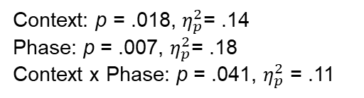
Skin Conductance
Acquisition
Extinction
p = .003, d = .51
p = .708, d = .06
Context: p = .018, $η_{p}^{2}$= .14
Phase: p = .007, $η_{p}^{2}$= .18
Context x Phase: p = .041, $η_{p}^{2}$ = .11

Slide 11
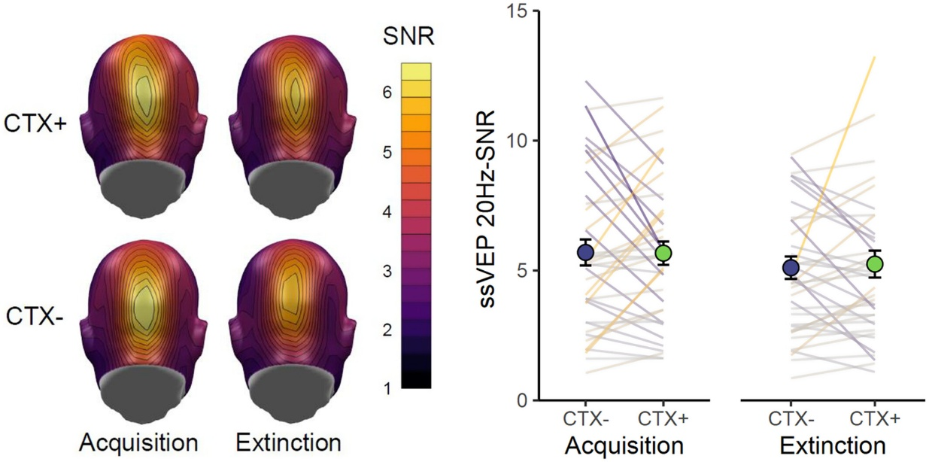
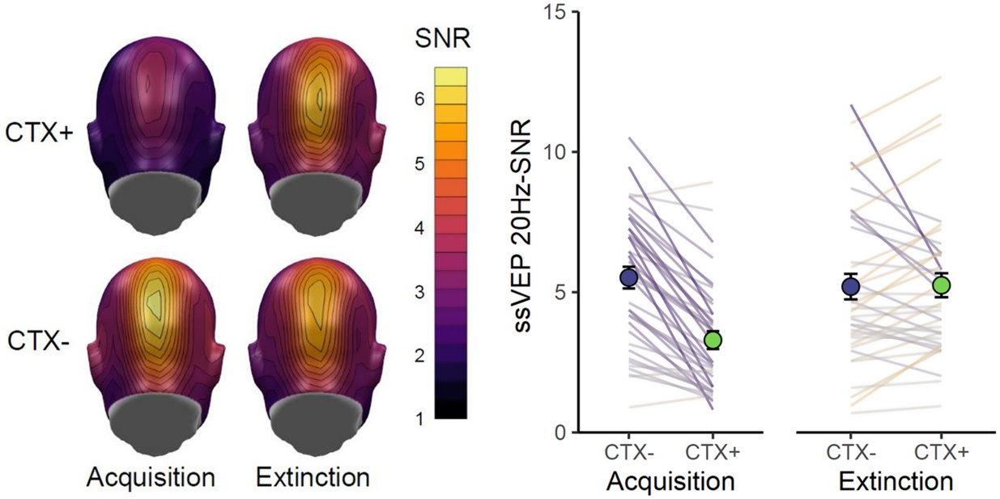
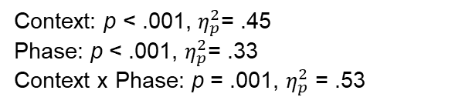
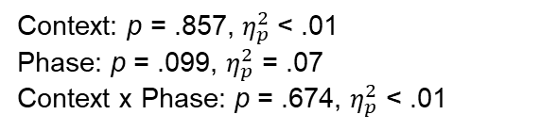
Visuocortical Responses
Initial response:
Sustained response:
Context: p = .857, $η_{p}^{2}$< .01
Phase: p = .099, $η_{p}^{2}$ = .07
Context x Phase: p = .674, $η_{p}^{2}$ < .01
Context: p < .001, $η_{p}^{2}$= .45
Phase: p < .001, $η_{p}^{2}$= .33
Context x Phase: p = .001, $η_{p}^{2}$ = .53

Slide 12
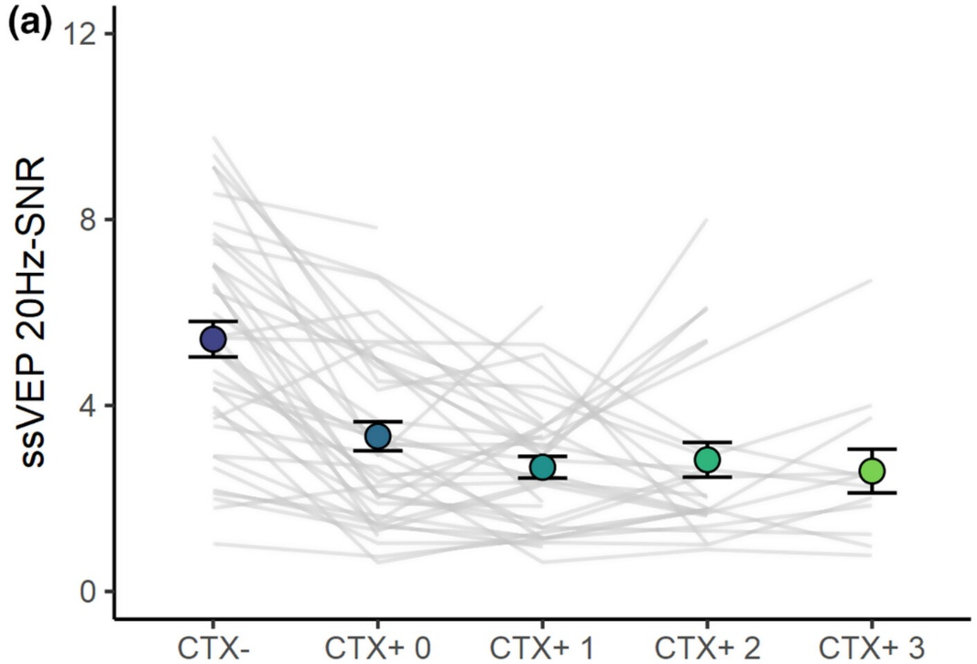
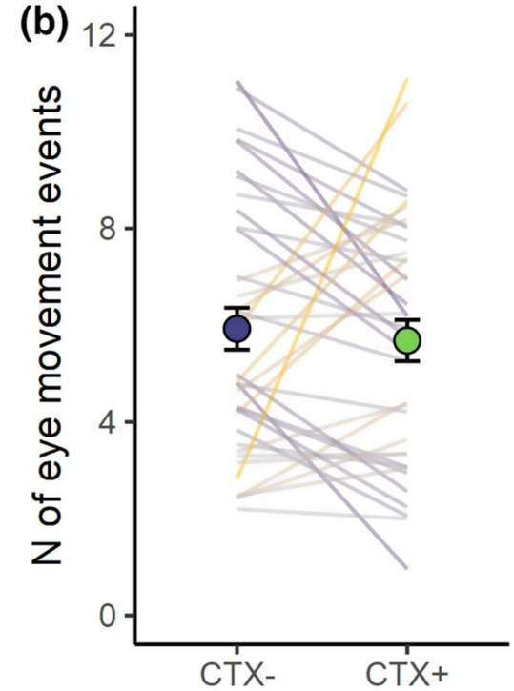
Visuocortical Responses
Sustained response:
p < .001, d = 1.17
p < .560, d = .10
Number of US prior to the response interval

Slide 13
Discussion
Successful context conditioning;
Behavior: Ratings
Physiology: Skin conductance
Visuocortical correlates of sustained attention:
In contrast to static images (Kastner-Dorn et al., 2015), no enhanced visuocortical activity for flickering videos.
Reduced ssVEP amplitudes during sustained response intervals, that cannot be explained by shock artefacts or eye-movements.
Sustained arousal may have led to a disruption of the ssVEP signal.
In line with findings from rapid serial visual presentation (RSVP) stream paradigms: Changes from neutral to unpleasant pictures was associated with reduced ssVEP amplitudes for the 6.66 Hz frequency. (Bekhtereva et al., 2018, Riels et al., 2020)

Slide 14

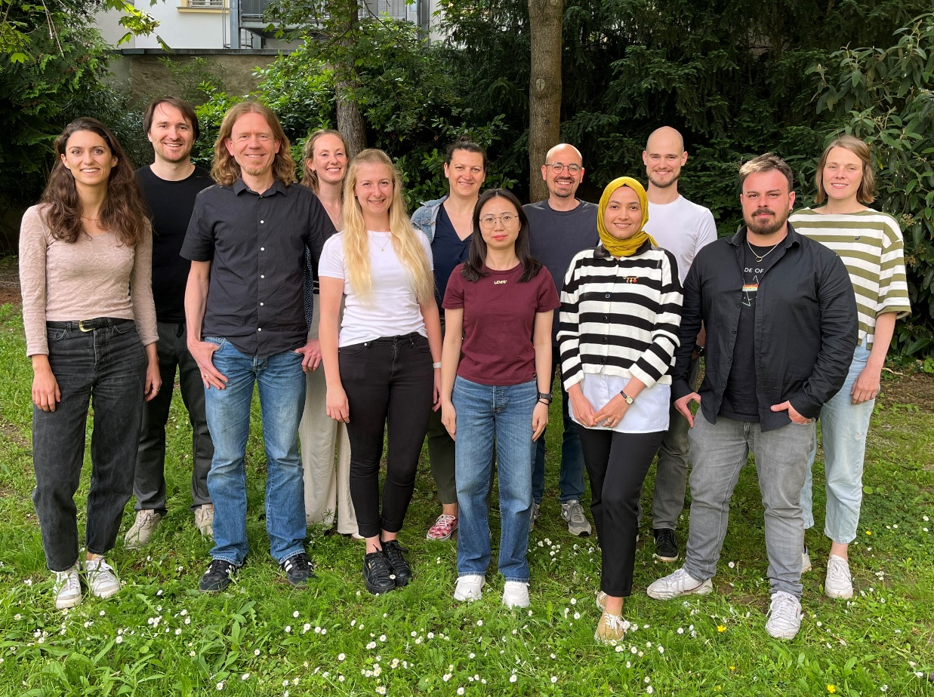
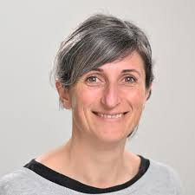
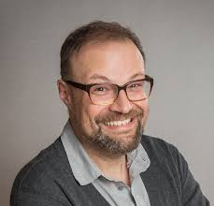

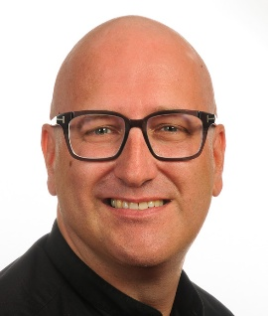
Special thanks:
Matthias Gamer
Lea Hildebrandt
Mario Reutter
Daniel Gromer
Alma Merscher
Janna Teigeler
Sabrina Gado
Francesco Tortora
Ebru Ecem Tavacioglu
Menghuan Chen
Marta Andreatta
Andreas Keil
Paul Pauli
Matthias J. Wieser
Yannik Stegmann - University of Würzburg
Mail: yannik.stegmann@uni-wuerzburg.de Twitter: @yannikstegmann

